Slide 1


R. GLENN
HUBBARD
ANTHONY PATRICK
O’BRIEN
FIFTH EDITION
© 2015 Pearson Education, Inc.

Slide 2
Fiscal Policy

Slide 3
Does government spending create jobs?
Government spending is a component of real GDP:
Y = C + I + G + NX
This makes it appear as though increases in government spending increase output—and hence other relevant economic variables like employment.
However some economists argue that government spending simply shifts employment from one group to another—it does not increase total employment.
This debate was particularly important after the 2007-2009 recession: can the government use discretionary fiscal policy to increase employment?

Slide 4
What is Fiscal Policy
16.1
Define fiscal policy.

Slide 5
Fiscal policy defined
Fiscal policy refers to changes in federal taxes and purchases that are intended to achieve macroeconomic policy objectives.
(State taxes and spending are not generally aimed at affecting national-level objectives.)
Some forms of government spending and taxes automatically increase or decrease along with the business cycle; these are automatic stabilizers.
Example: Unemployment insurance payments are larger during a recession.
Discretionary fiscal policy, on the other hand, refers to intentional actions the government takes to change spending or taxes.

Slide 6
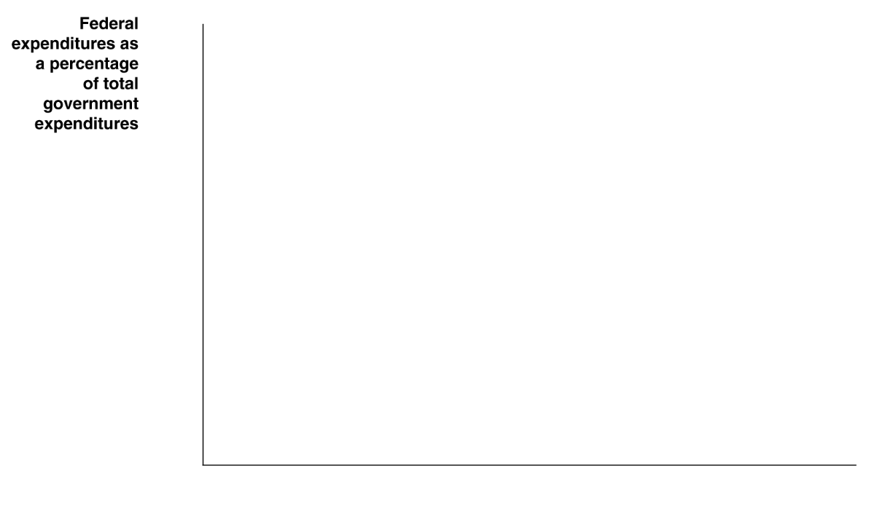

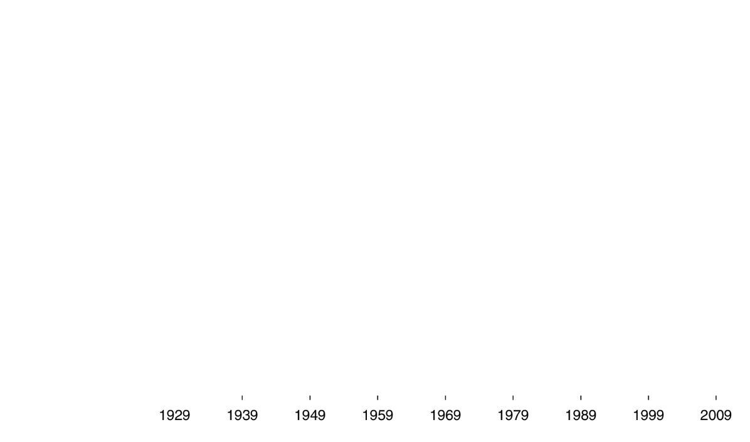
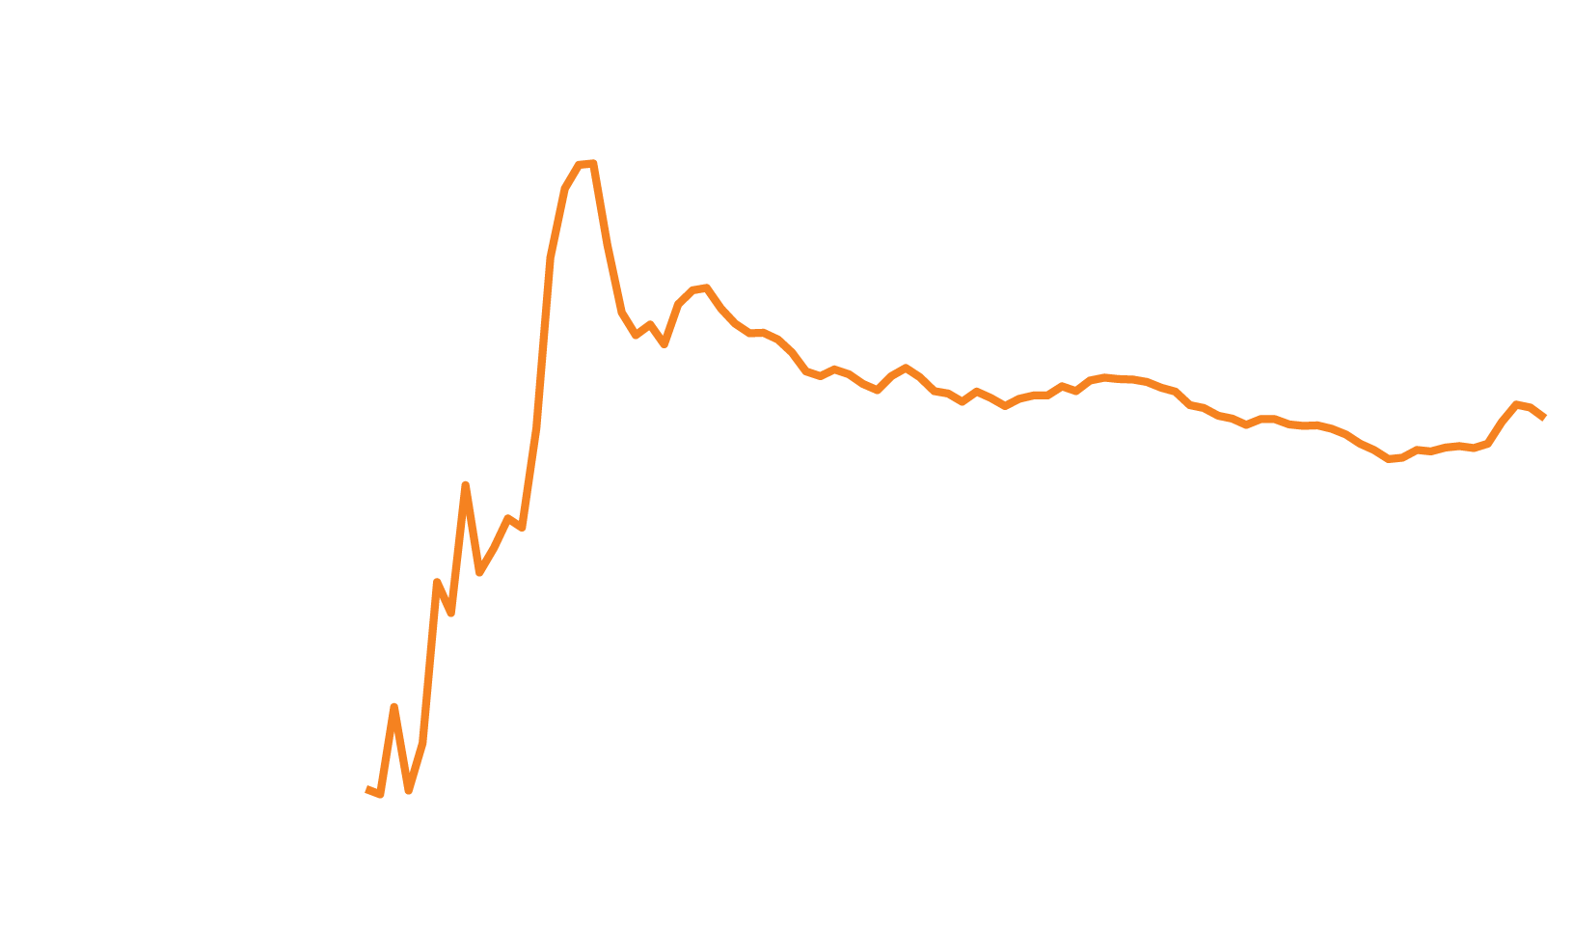


How much government spending is federal?
Before the Great Depression of the 1930s, most government spending was at the state or local level;
now the federal government’s share is two-thirds to three-quarters.
Figure 16.1
The federal government’s share of total expenditures, 1929-2012
Notes:
Until the Great Depression of the 1930s,
the majority of government spending in
the United States occurred at the state and
local levels. Since World War II, the federal
government’s share of total government expenditures
has been between two-thirds and
three-quarters.
Source: U.S. Bureau of Economic Analysis.

Slide 7
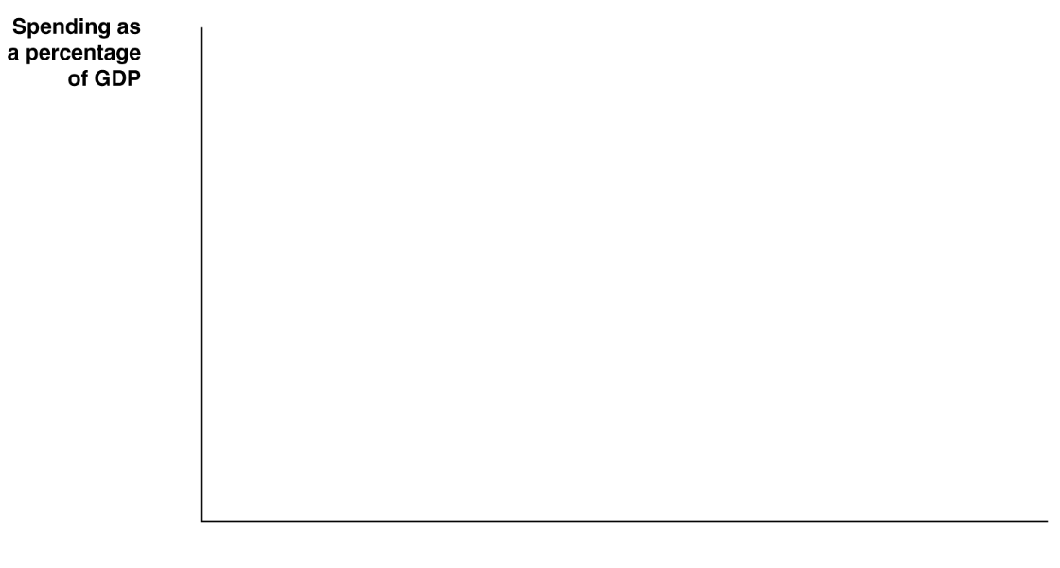

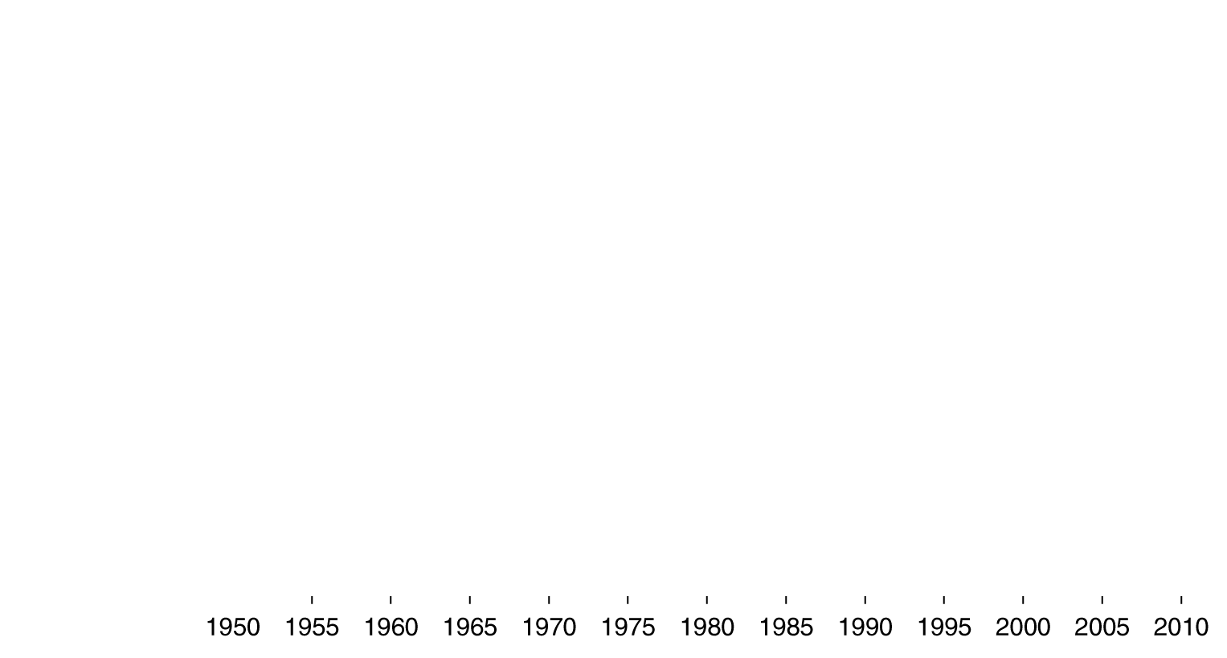


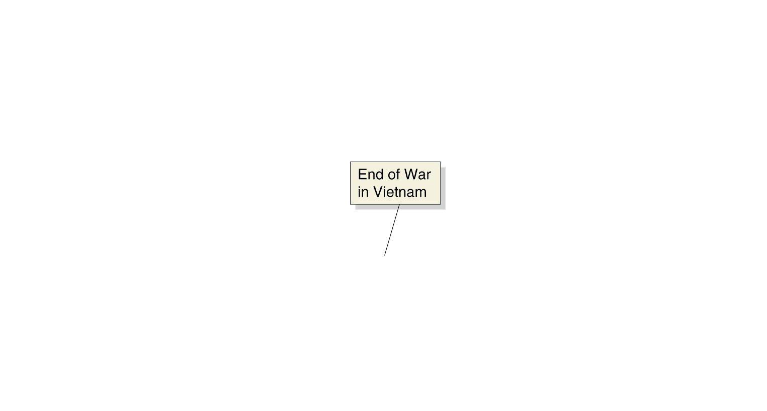


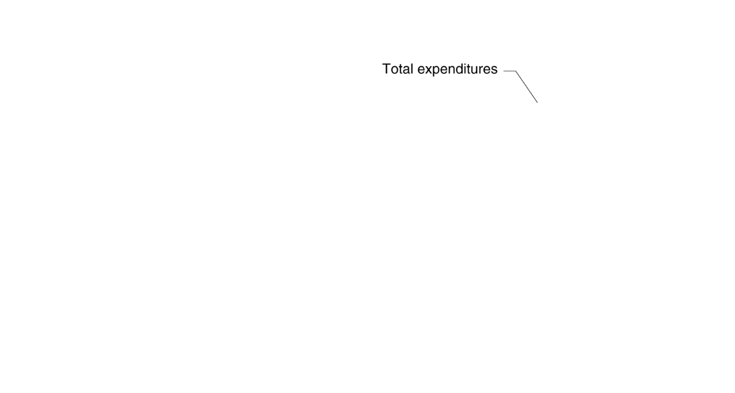

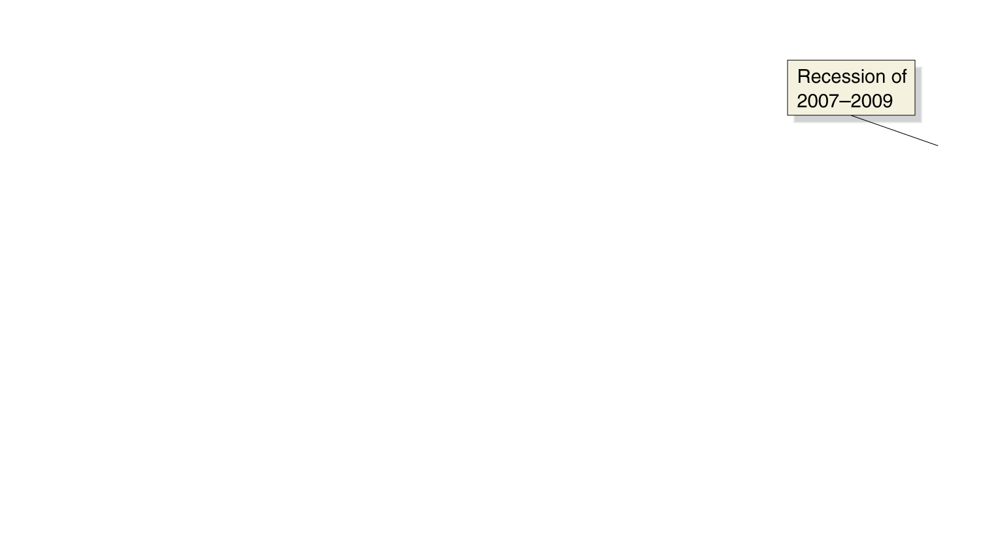
Federal expenditures as a percentage of GDP
As a percentage of GDP, federal expenditures are now higher than ever—almost 25% of GDP.
However a smaller proportion is now spent on government purchases of goods and services (mostly military spending).
Figure 16.2
Federal purchases and federal expenditures as a percentage of GDP, 1950-2012
Notes:
As a fraction of GDP, the federal government’s
purchases of goods and services
have been declining since the Korean War
in the early 1950s. Total expenditures by
the federal government—including transfer
payments—as a fraction of GDP slowly rose
from 1950 through the early 1990s and fell
from 1992 to 2001, before rising again. The
recession of 2007–2009 and the slow recovery
that followed led to a surge in federal
government expenditures, causing them to
rise to their highest level as a percentage of
GDP since World War II.
Source: U.S. Bureau of Economic Analysis.

Slide 8

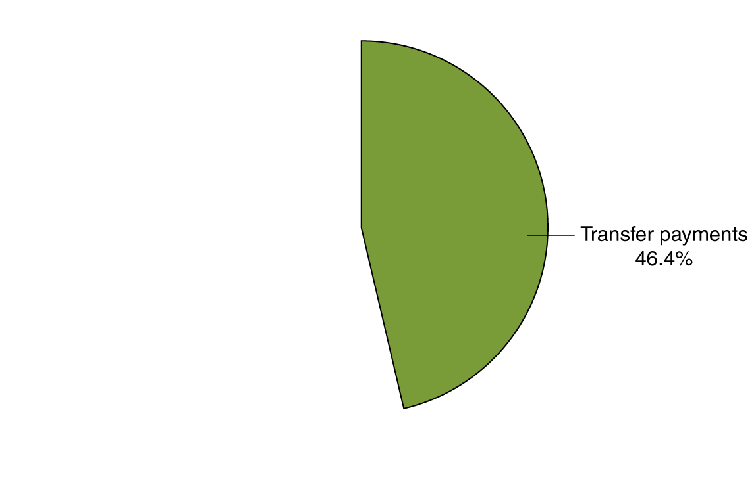
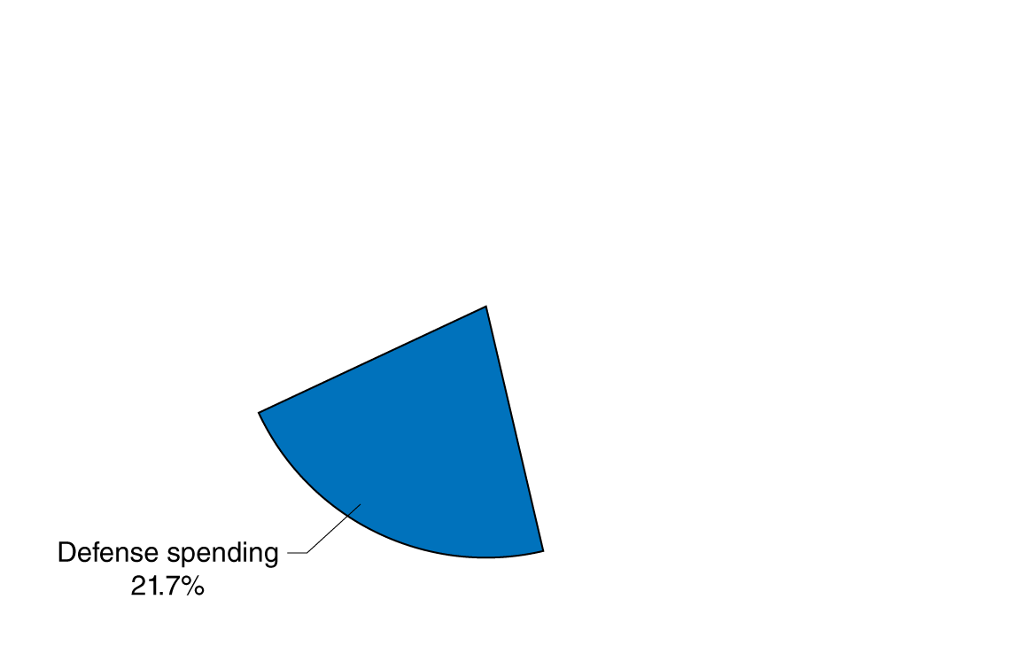
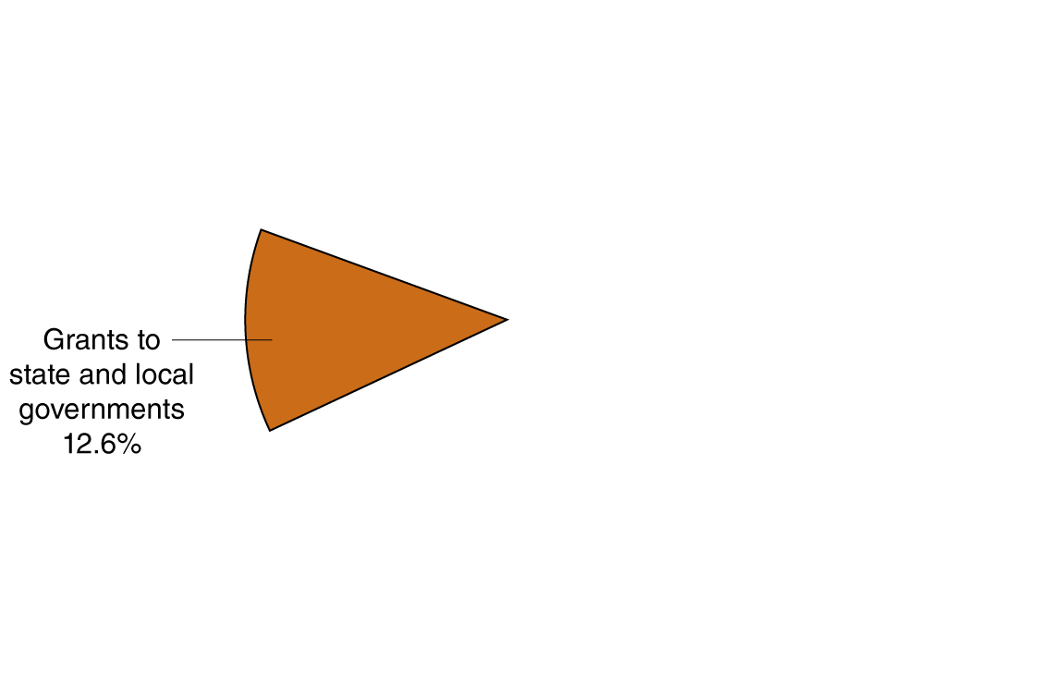
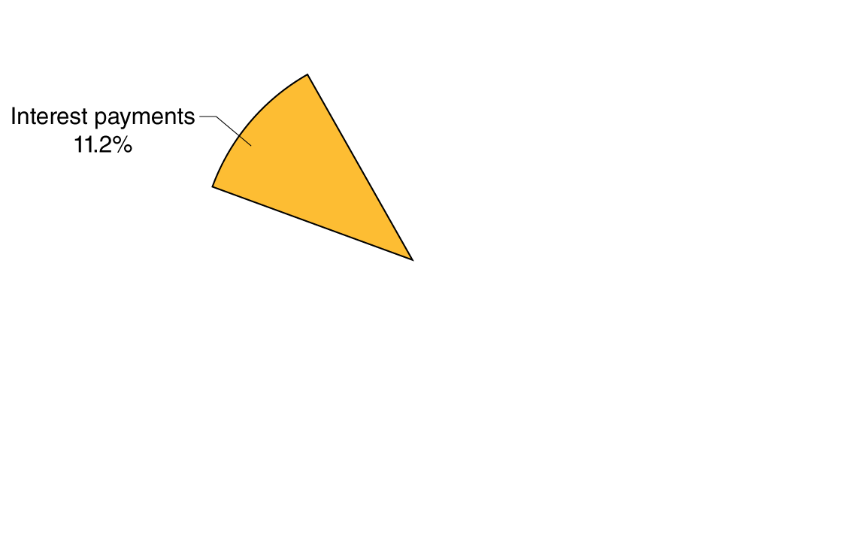
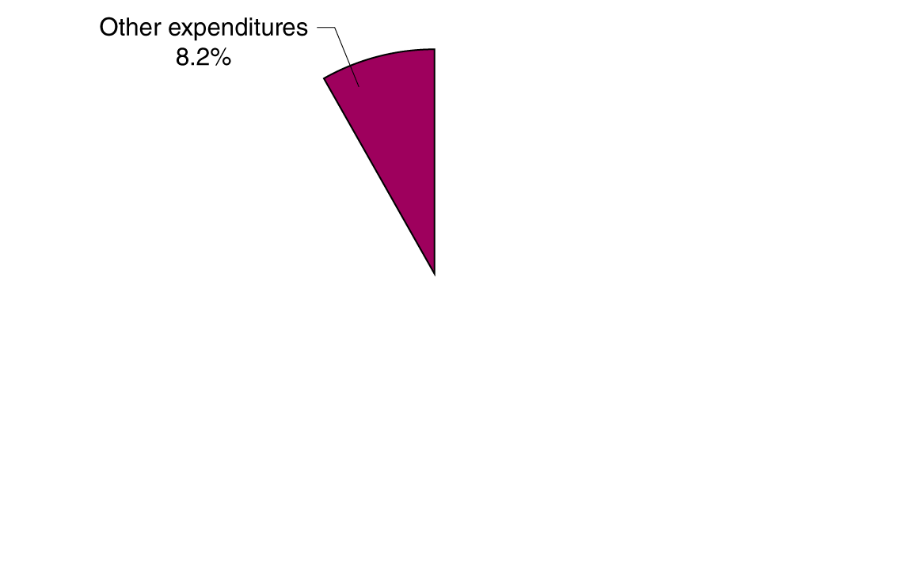
What does the federal government spend money on?
Federal purchases consist of defense spending and “everything else”, like salaries of FBI agents, operating national parks, and funding scientific research.
Around half of federal expenditures are spent on transfer payments, like Social Security, Medicare, and unemployment insurance.
The rest is spent on grants to state and local governments to support their activities, like crime prevention and education; and on paying interest on the federal debt.
Figure 16.3
Federal government expenditures, 2012
Notes:
Federal government purchases can be divided
into defense spending—which makes
up 21.7 percent of the federal budget—and
spending on everything else the federal government
does—from paying the salaries of
FBI agents, to operating the national parks,
to supporting scientific research—which
makes up 8.2 percent of the budget. In addition
to purchases, there are three other
categories of federal government expenditures:
interest on the national debt, grants
to state and local governments, and transfer
payments. Transfer payments rose from 25
percent of federal government expenditures
in the 1960s to 46.4 percent in 2012.
Source: U.S. Bureau of Economic Analysis.

Slide 9

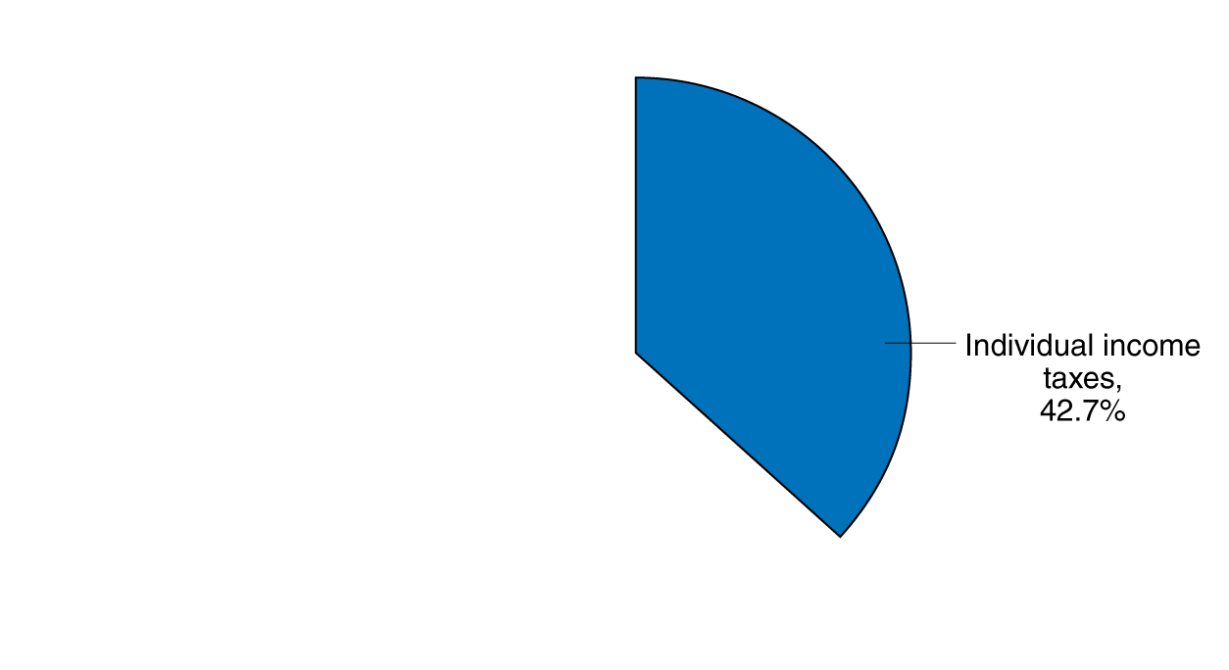
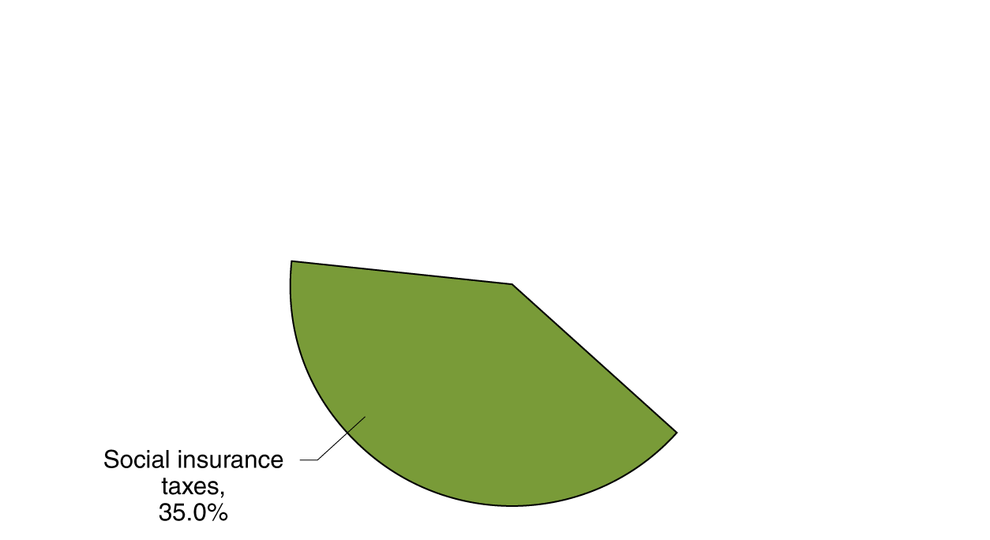
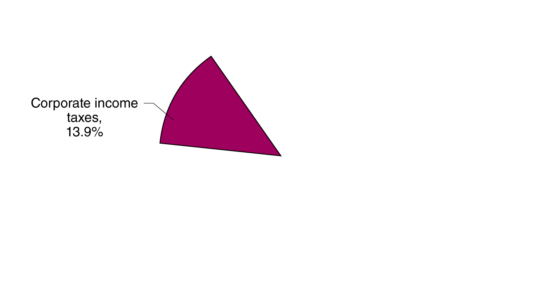
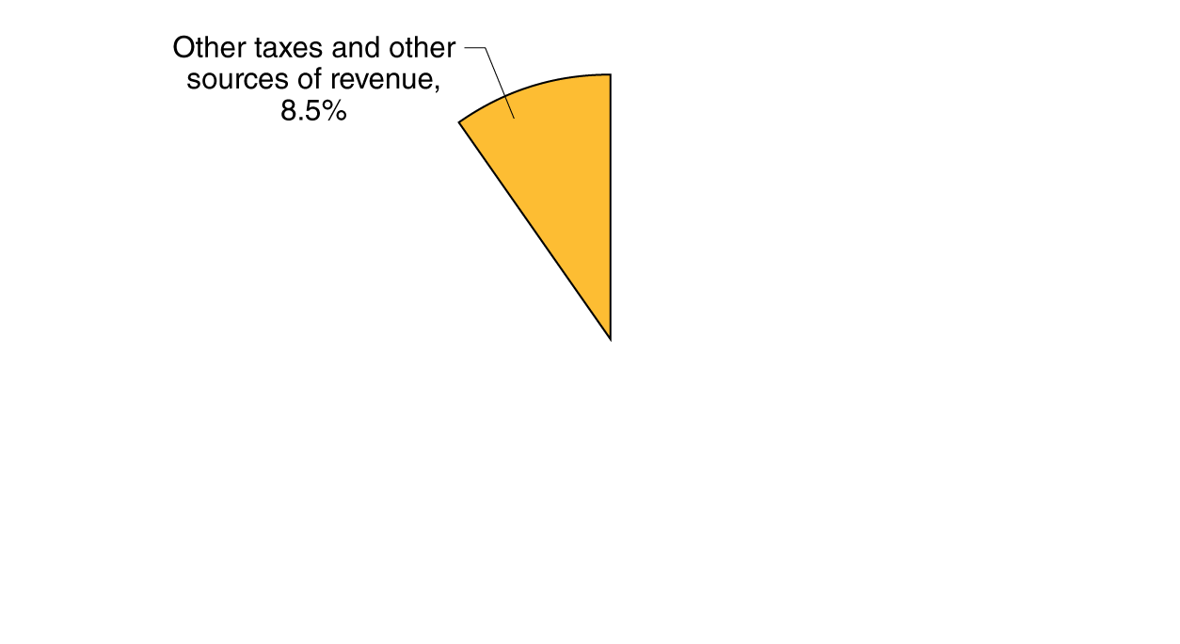
What does the federal government spend money on?
The majority of federal revenues come from taxes on individual employment: individual income taxes, and “payroll taxes” earmarked to fund Social Security and Medicare.
Taxes on corporate profits constitute about one-seventh of federal receipts.
The remainder of federal revenue comes from excise taxes (on cigarettes, gasoline, etc.), tariffs on imports, and other fees from firms and individuals.
Figure 16.4
Federal government revenue, 2012
Notes:
In 2012, individual income taxes raised 42.7
percent of the federal government’s revenues.
Corporate income taxes raised 13.9
percent of revenue. Payroll taxes to fund
the Social Security and Medicare programs
raised 35.0 percent of revenue. The remaining
8.5 percent of revenues were raised from
excise taxes, tariffs on imports, and other
sources.
Source: U.S. Bureau of Economic Analysis.

Slide 10


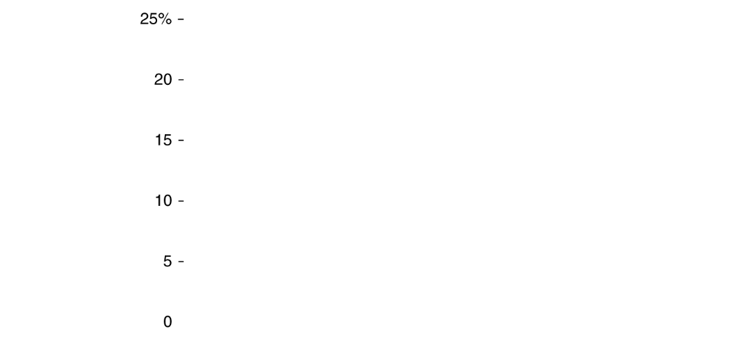


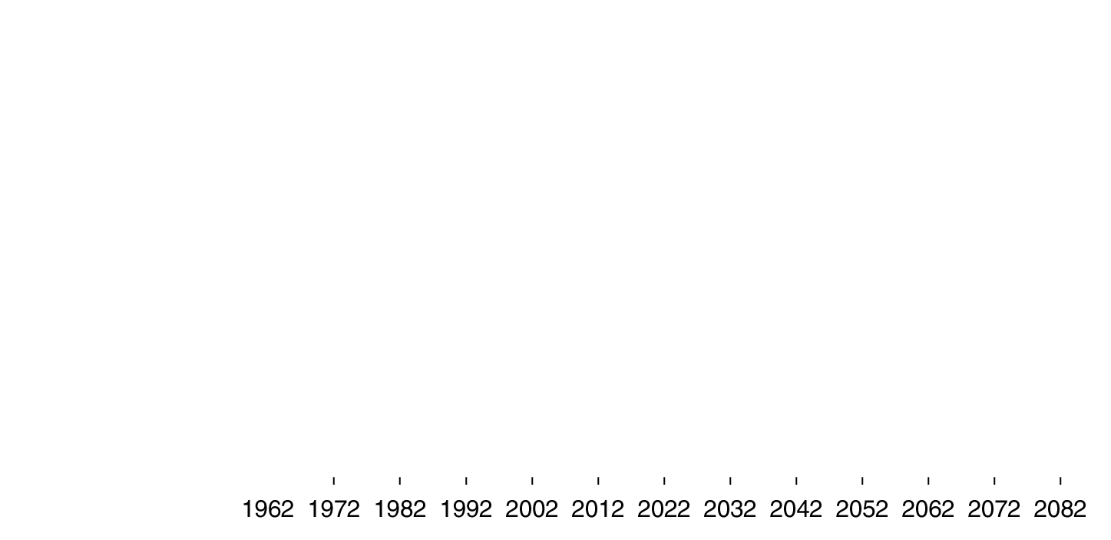
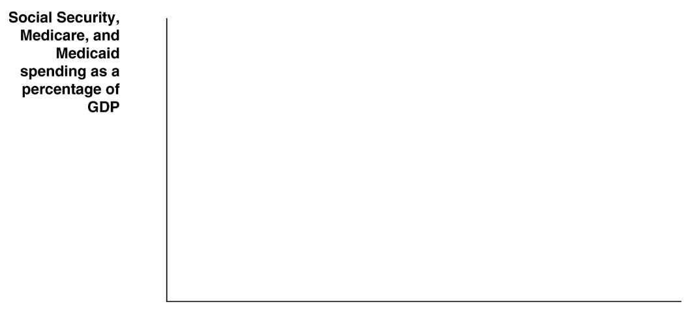
Social Security and Medicare: fiscal time bombs?
Social Security and Medicare have helped to reduce poverty among the elderly, while Medicaid helps improve the health of poor people.
But the aging population and rising health care costs are combining to put those programs in jeopardy.
Through 2090, the budget shortfall for these programs is estimated to be enormous: almost $60 trillion.

Slide 11
Social Security and Medicare: is there a fix?
How can these programs continue to exist?
It is likely that a combination of these measures will eventually need to be adopted:
Increasing taxes
Decreasing benefits (including slower benefit growth, perhaps differently for different income groups)
Decreasing eligibility (SSI age already increasing from 65 to 67)
But perhaps the most important element will be finding a way to reduce medical costs.

Slide 12
The Effects of Fiscal Policy on Real GDP and the Price Level
16.2
Explain how fiscal policy affects aggregate demand and how the government can use fiscal policy to stabilize the economy.

Slide 13
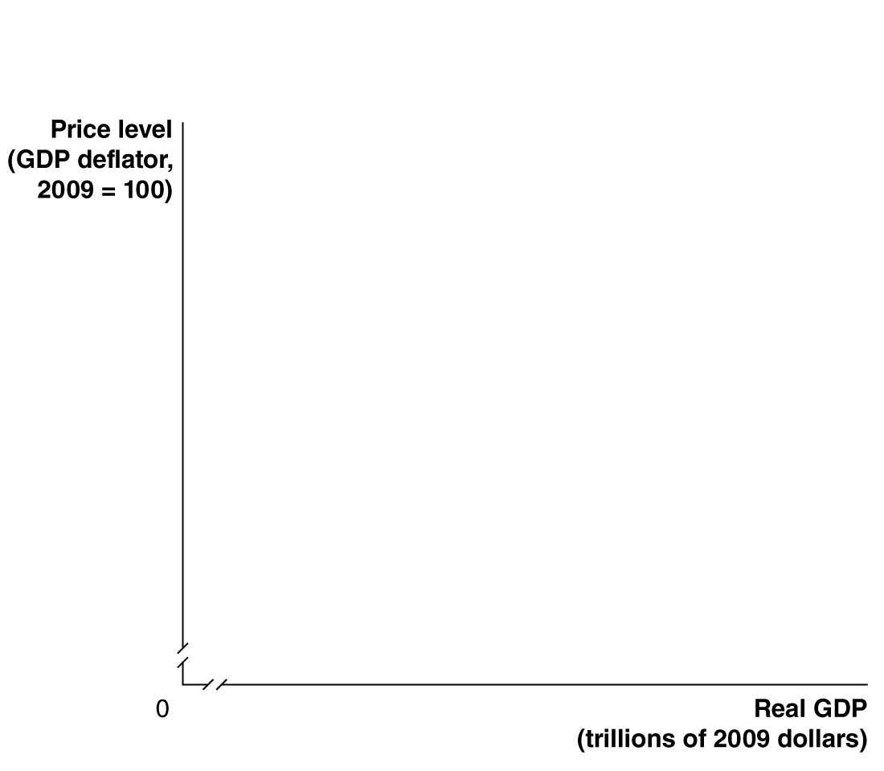
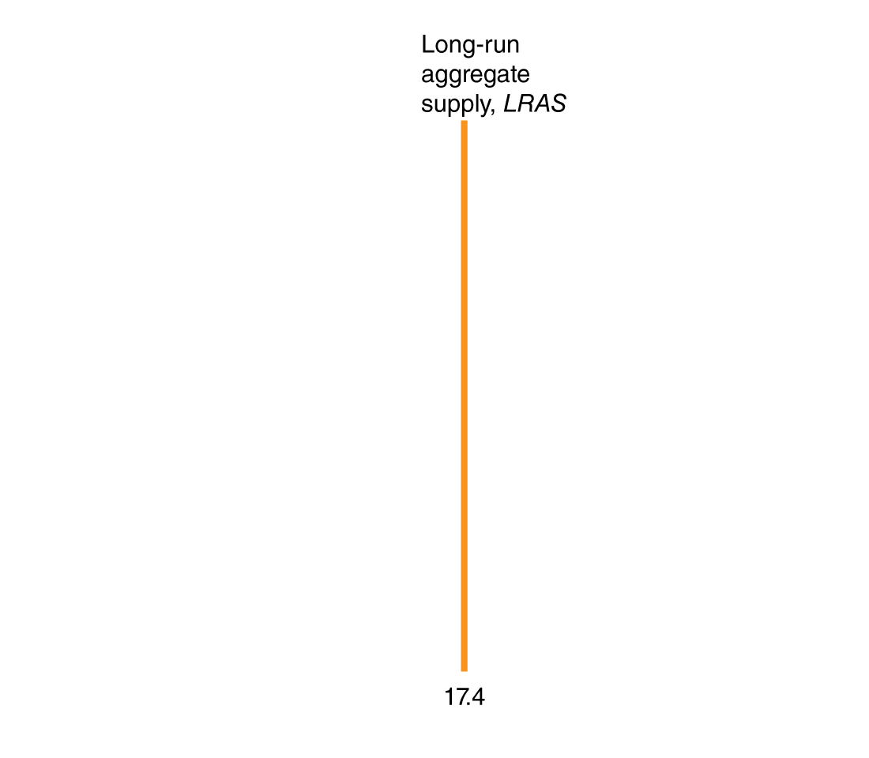
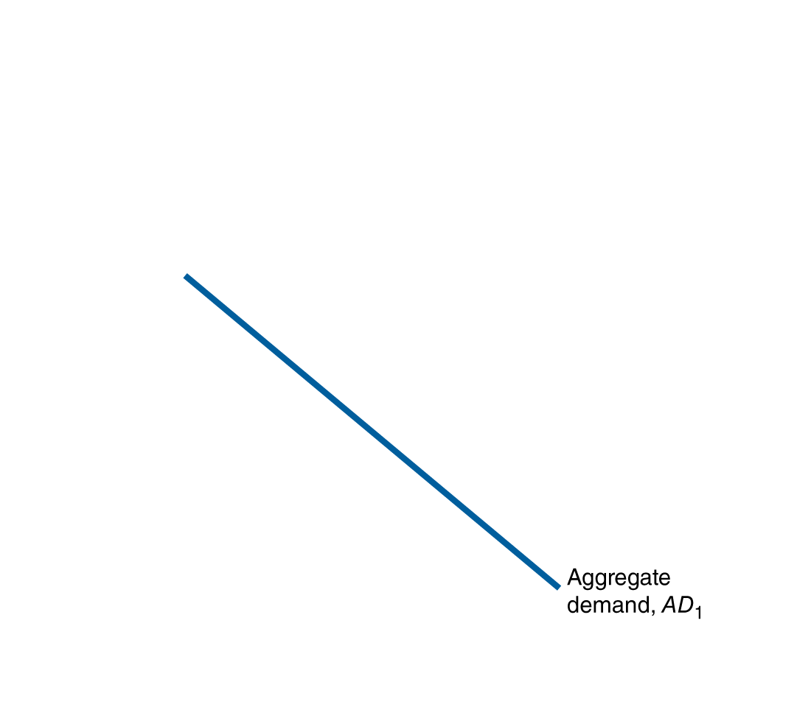
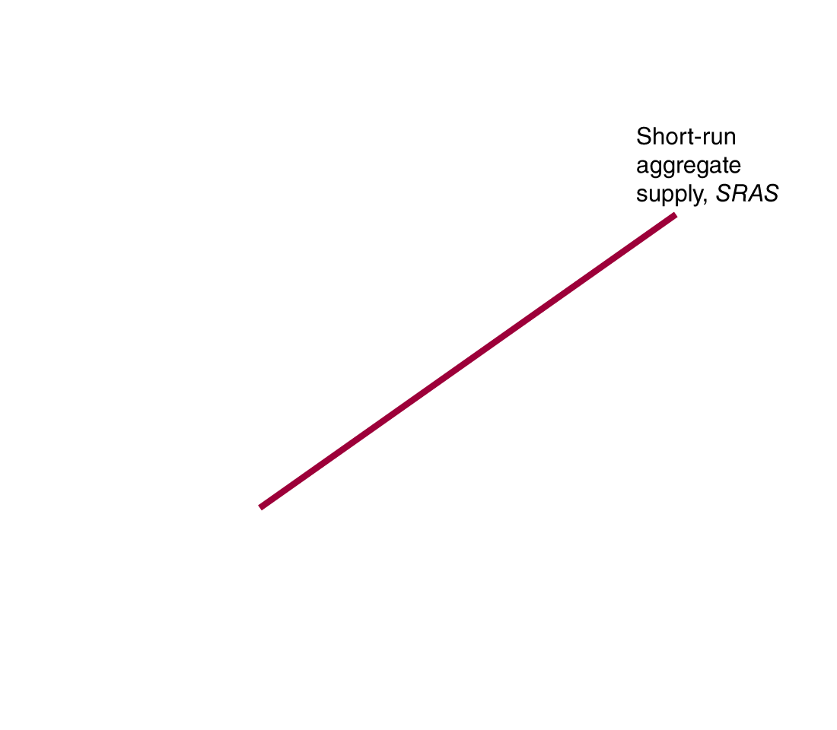
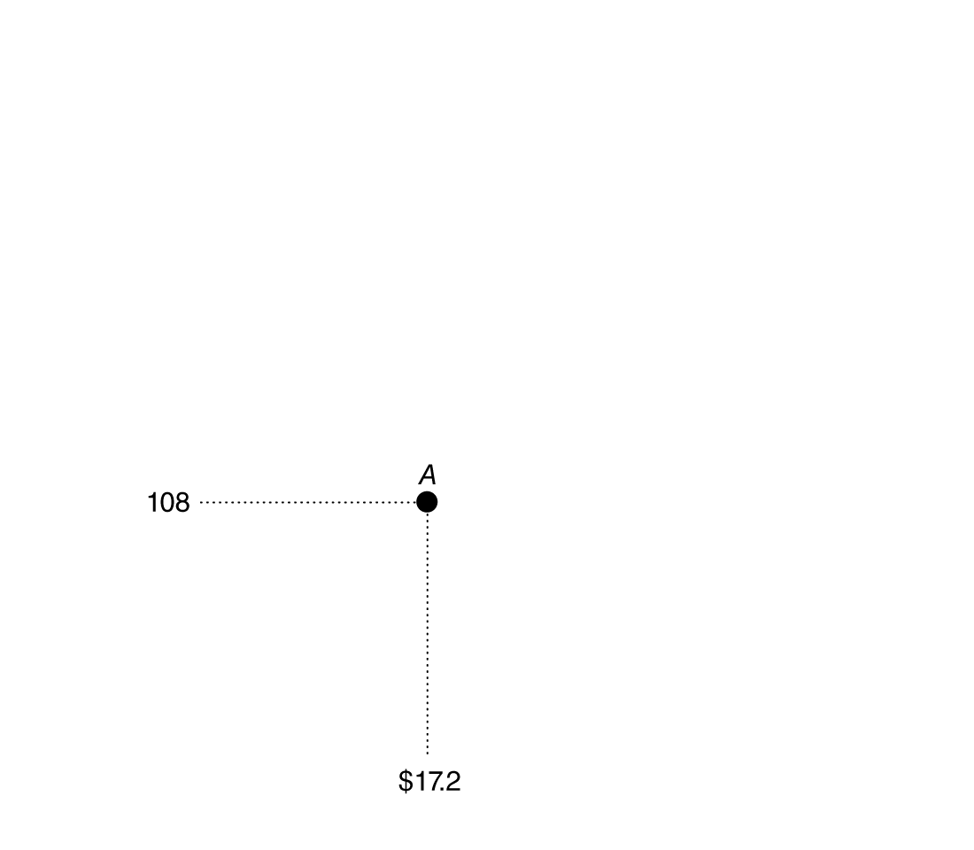
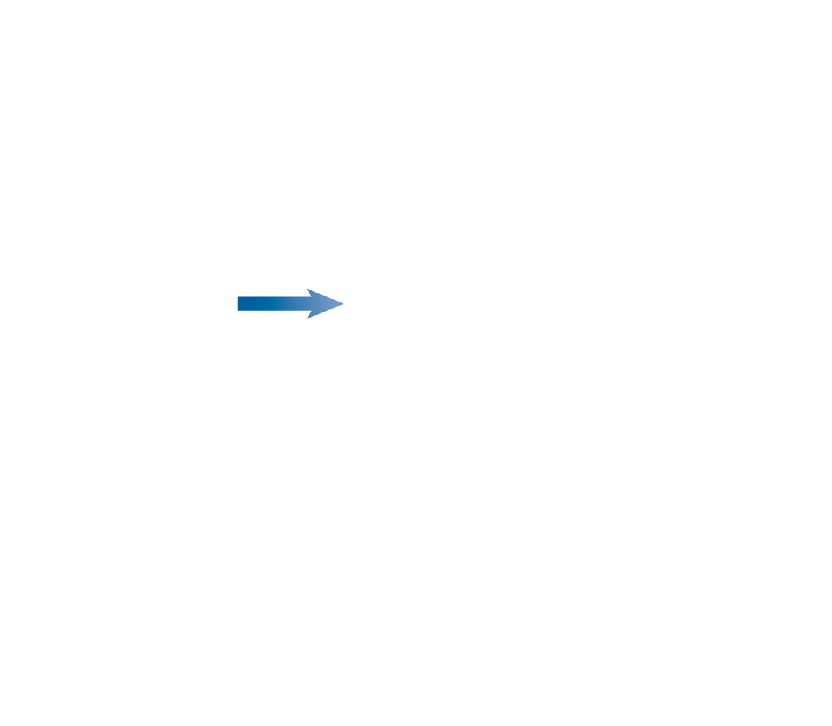
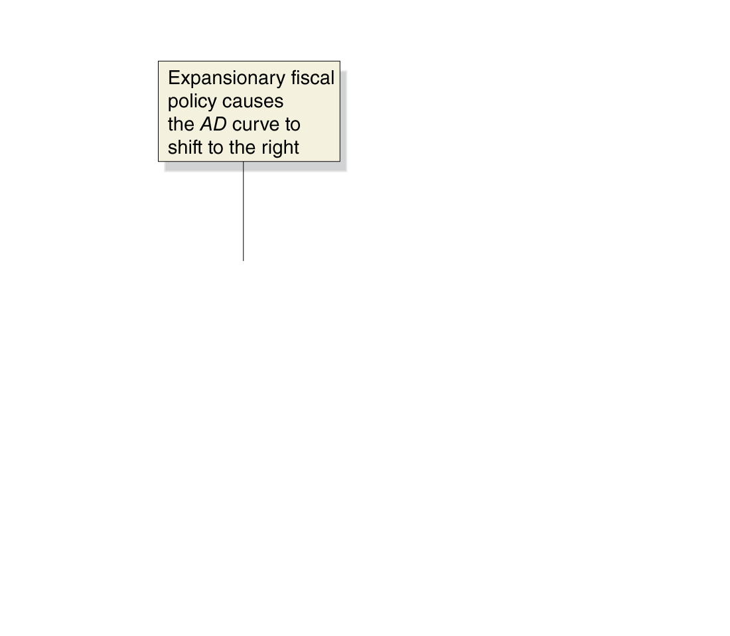
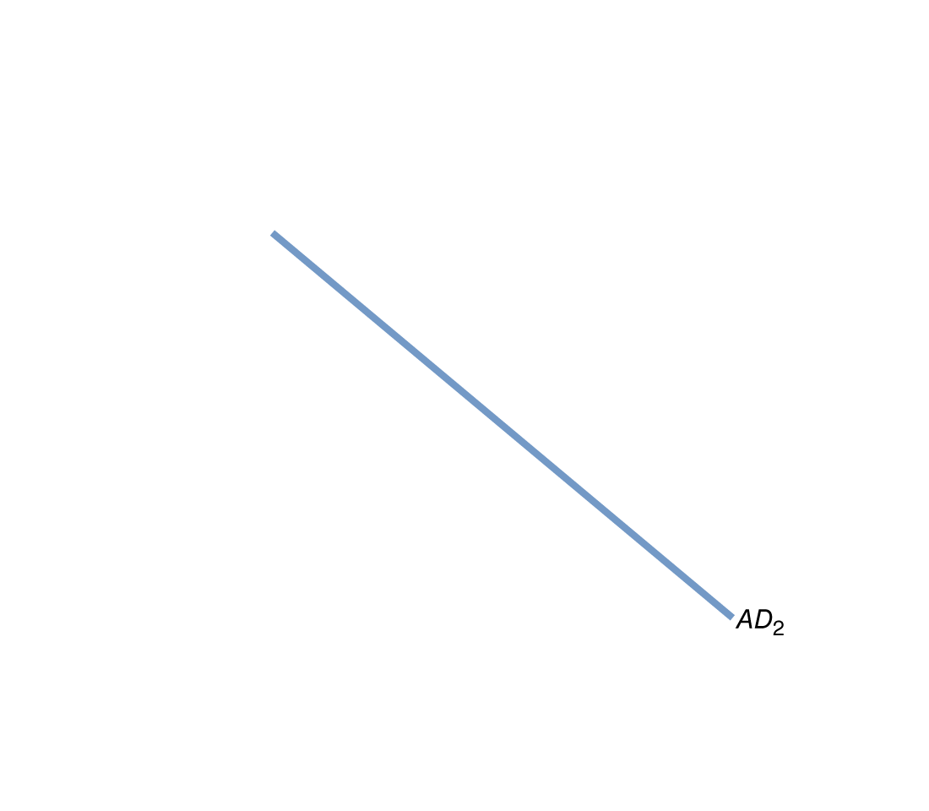
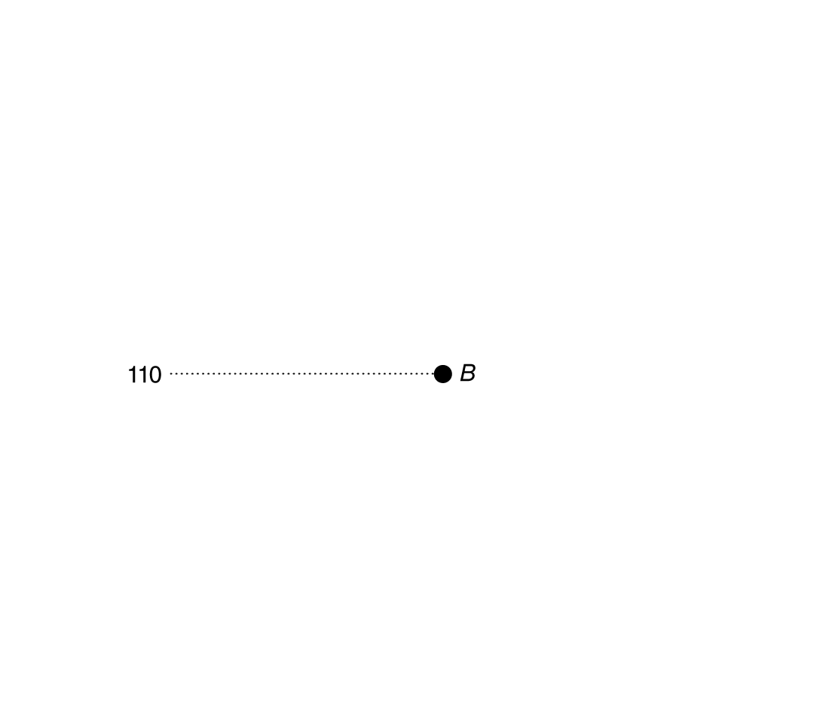
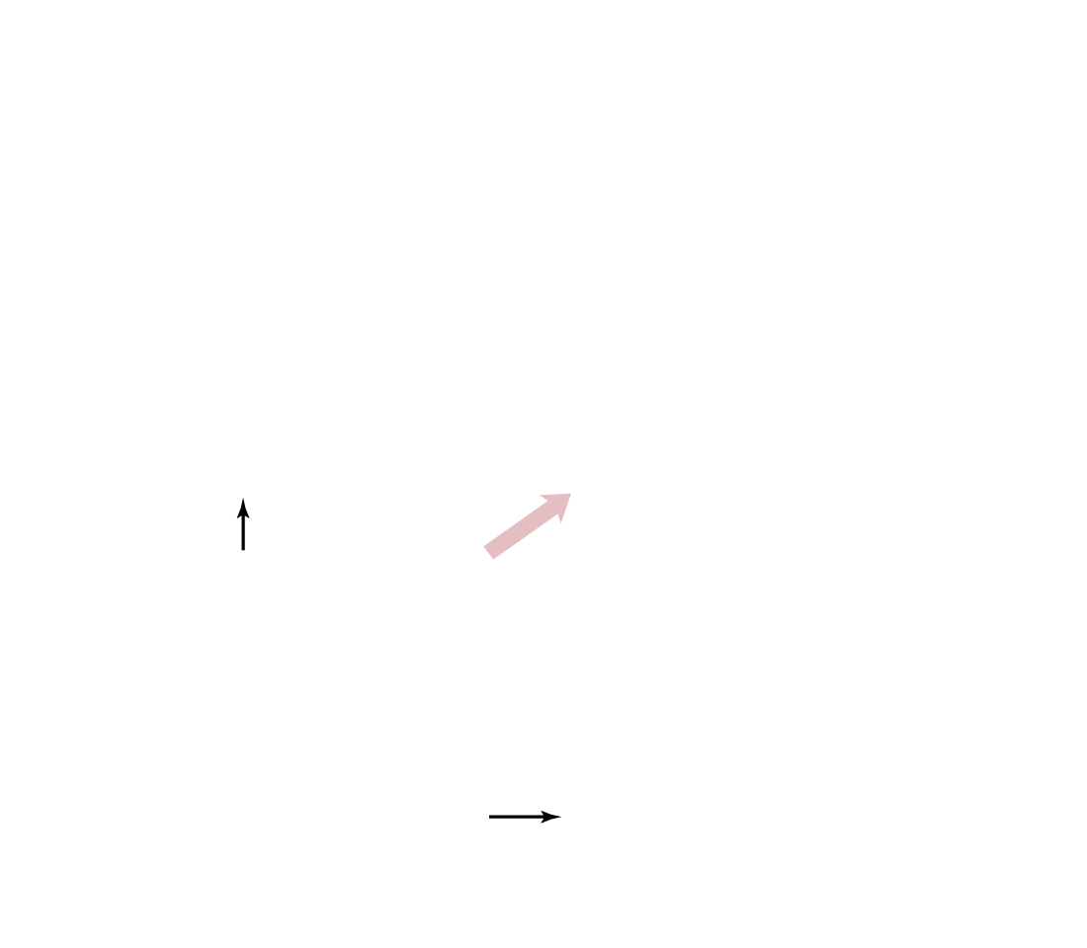
Expansionary fiscal policy in the AD-AS model
Expansionary fiscal policy involves increasing government purchases or decreasing taxes.
Increasing government purchases directly increases aggregate demand.
Decreasing taxes indirectly affects aggregate demand by increasing disposable income, and hence consumption spending.
Figure 16.5a
Fiscal policy
If the government believes real GDP will be below potential GDP, it can enact expansionary fiscal policy in an attempt to restore long-run equilibrium—decreasing unemployment.
Notes:
In panel (a), short-run equilibrium is at point A, with real GDP of $17.2 trillion
and a price level of 108. Real GDP is below potential GDP, so the economy is in a
recession. An expansionary fiscal policy will cause aggregate demand to shift to
the right, from AD1 to AD2, increasing real GDP from $17.2 trillion to $17.4 trillion
and the price level from 108 to 110 (point B).
In panel (b), the economy begins
at point A, with real GDP at $17.6 trillion and
the price level at 112. Because
real GDP is greater than potential GDP, the economy
will experience rising wages and prices. A contractionary fiscal policy will
cause aggregate demand to shift to the left, from AD1 to AD2, decreasing real GDP
from $17.6 trillion to $17.4 trillion and the price level from 112 to 110 (point B).

Slide 14
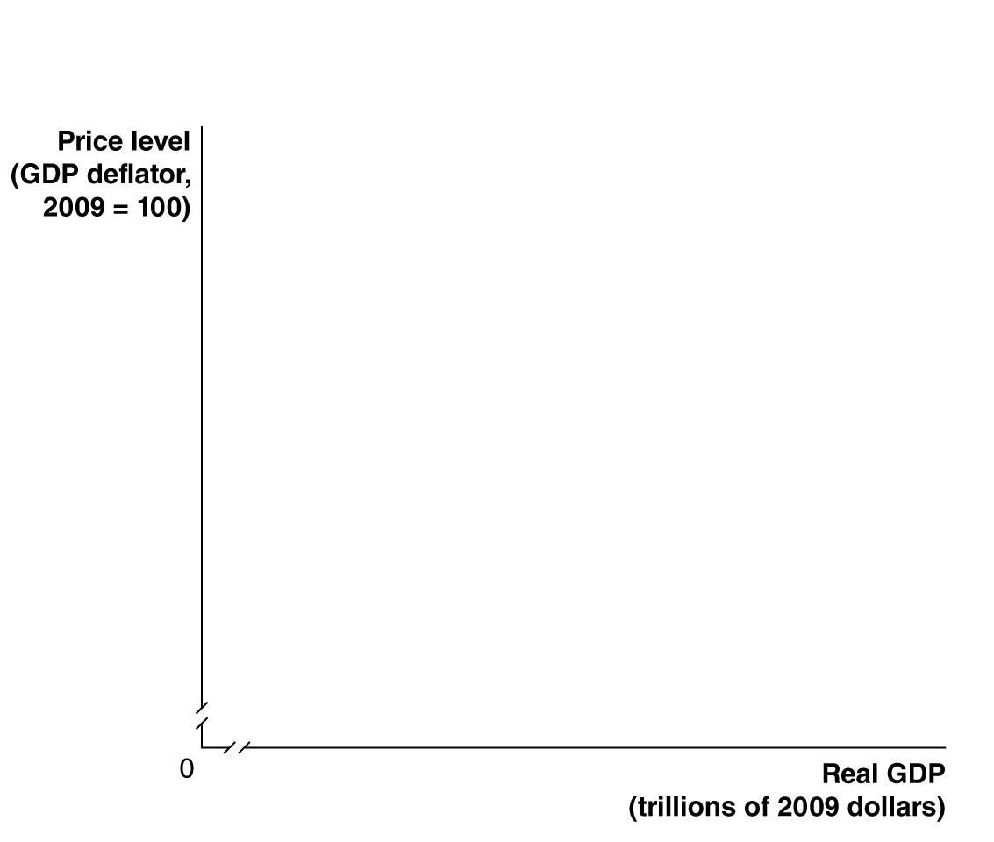

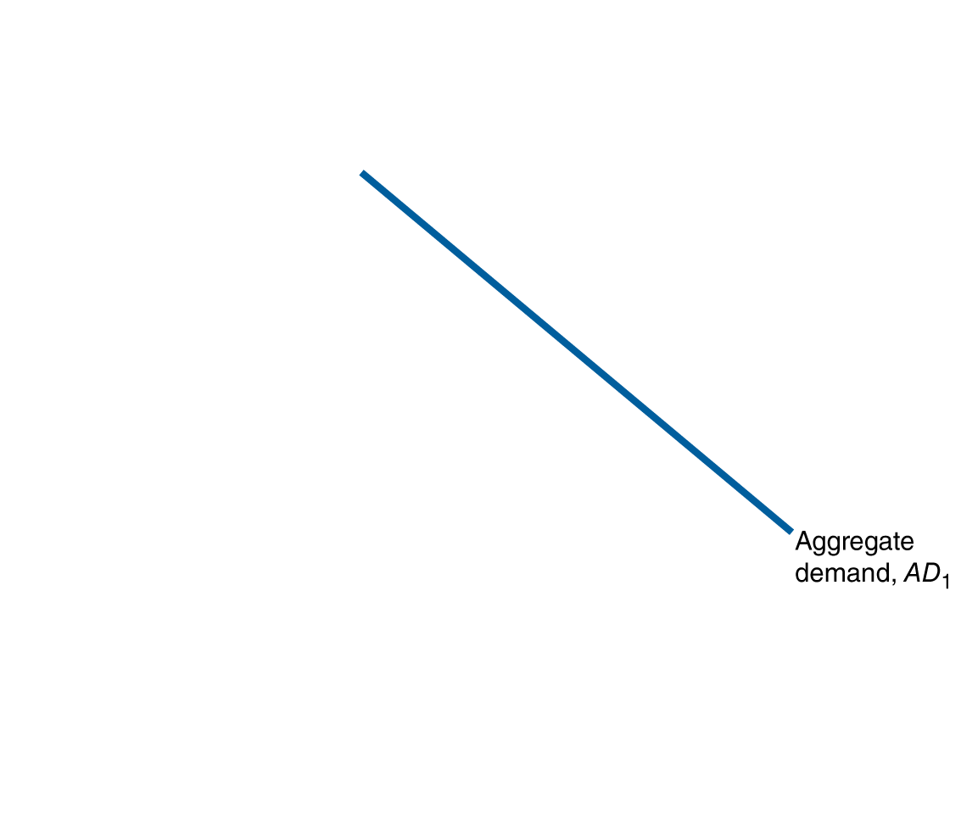
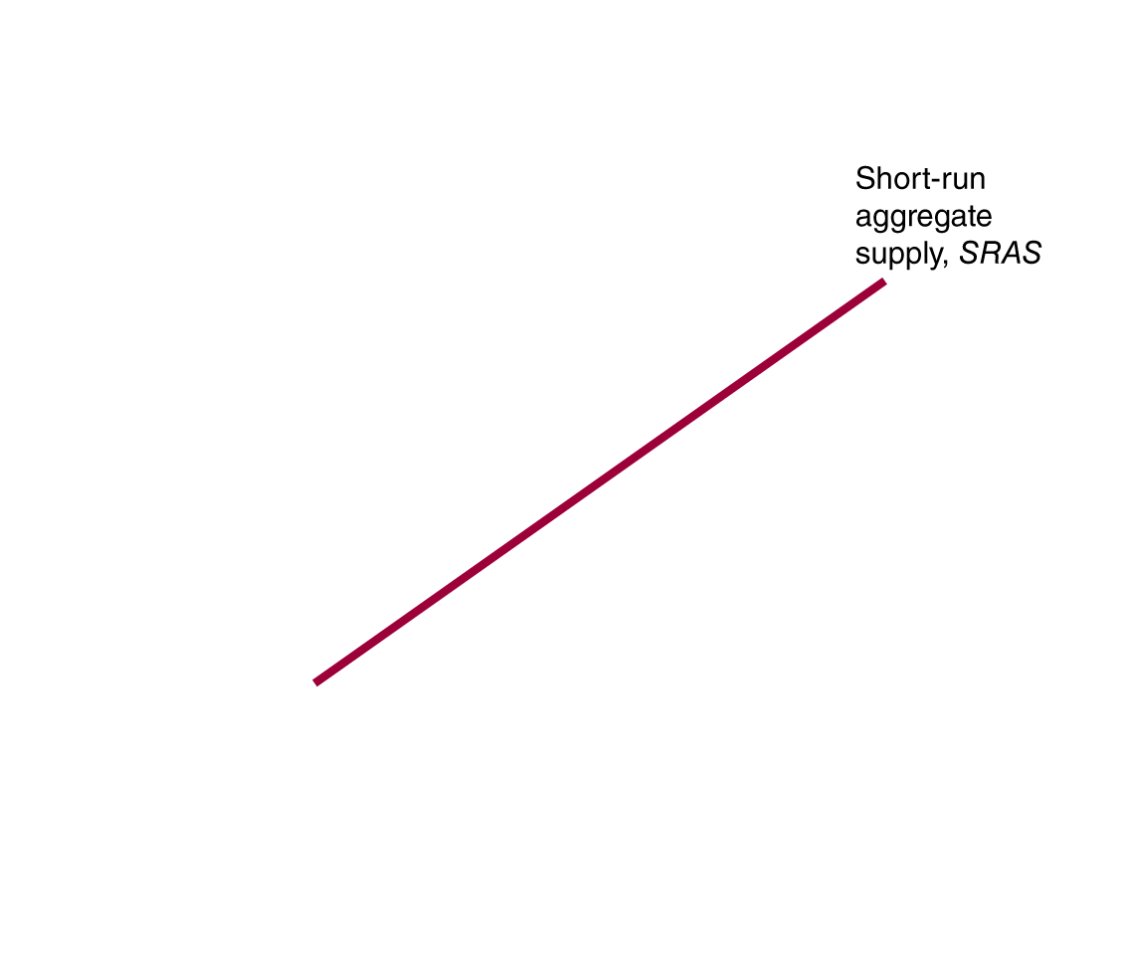
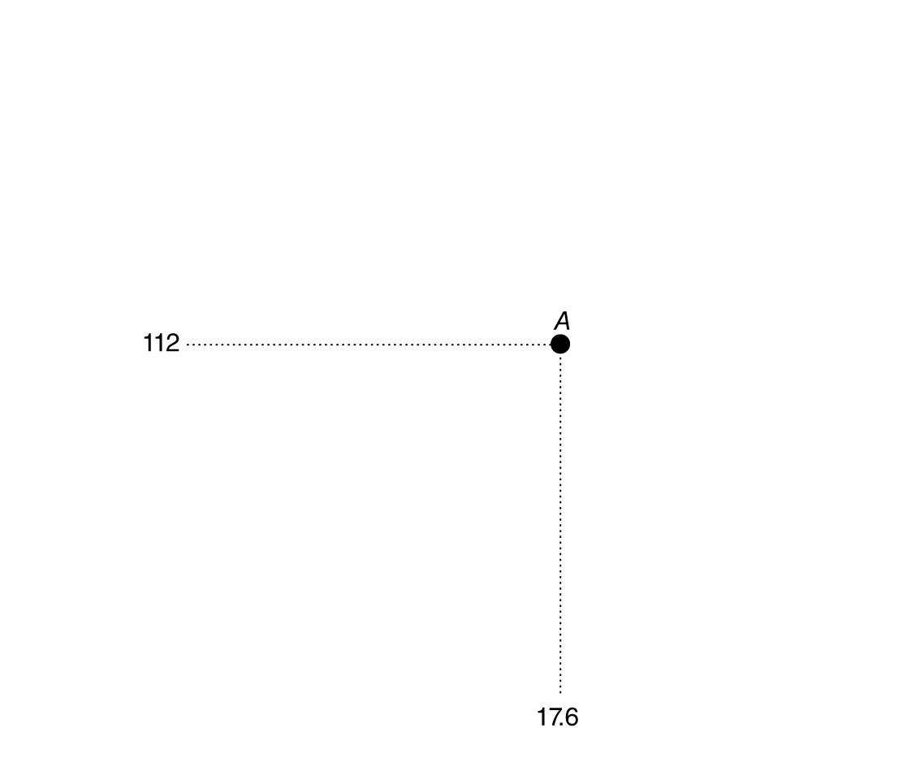

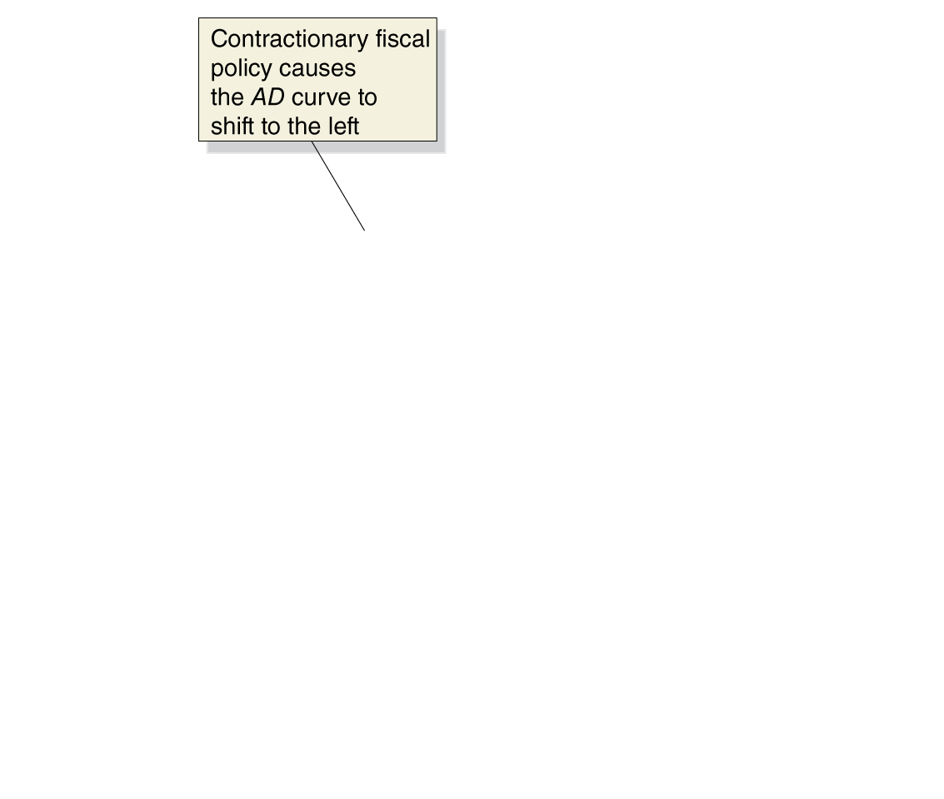
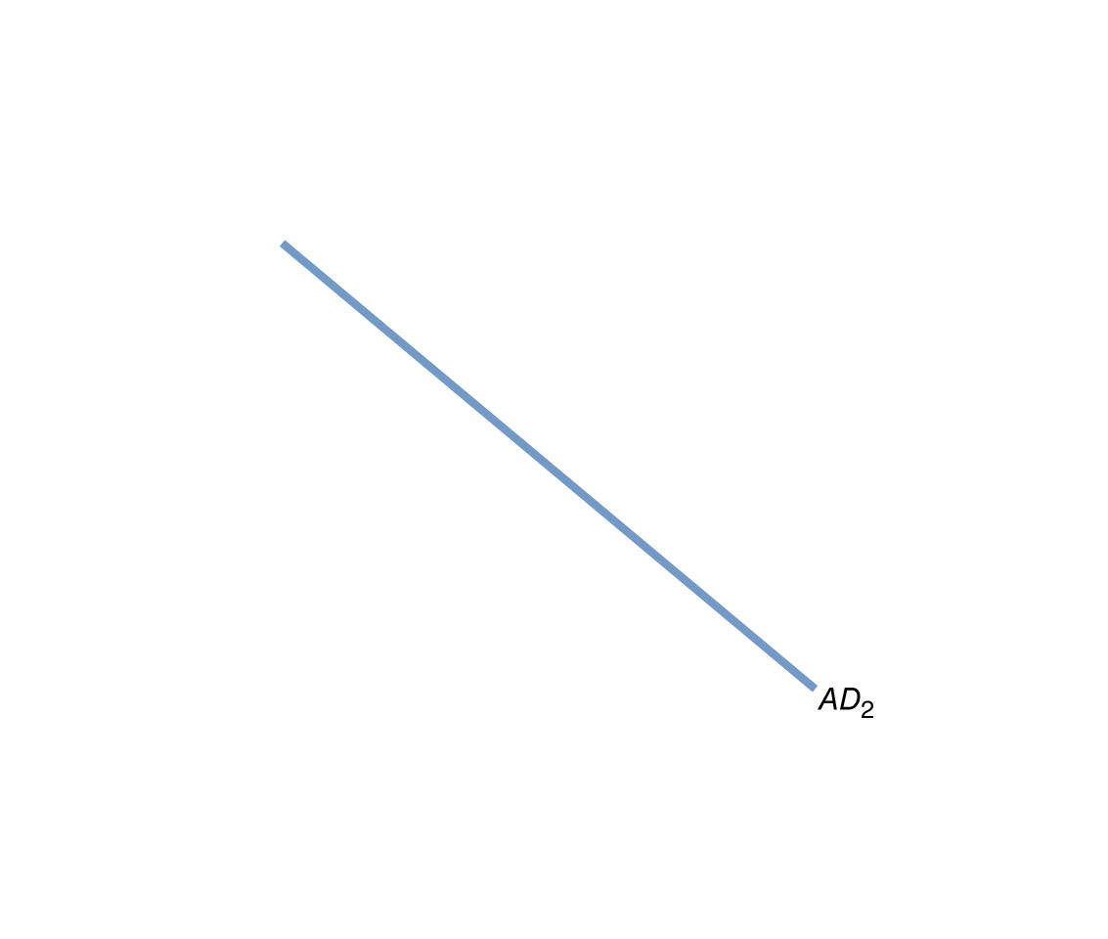
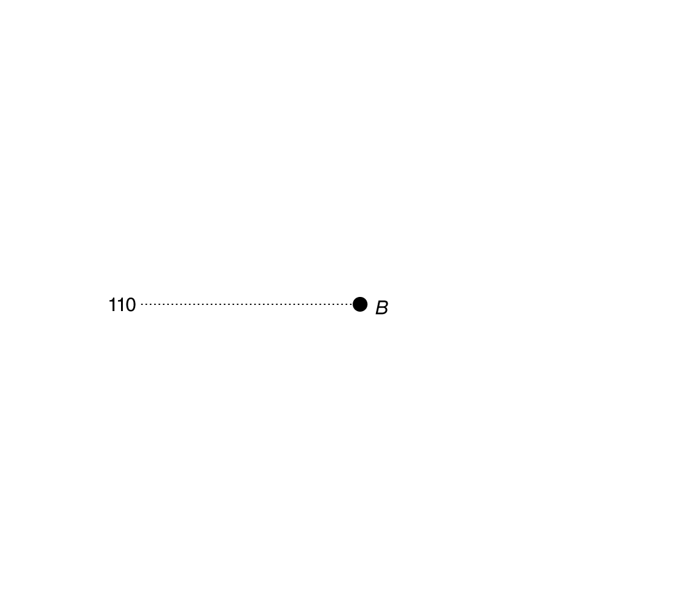
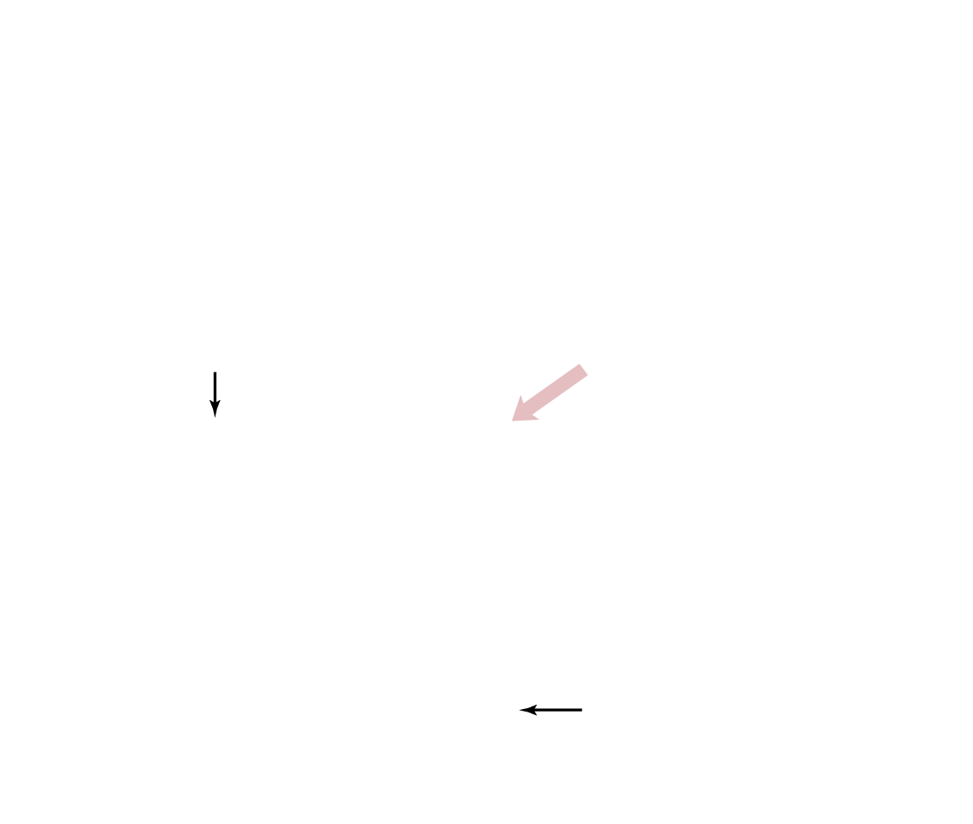
Contractionary fiscal policy in the AD-AS model
Contractionary fiscal policy involves decreasing government purchases or increasing taxes.
This works just like expansionary fiscal policy, only in reverse.
Figure 16.5b
Fiscal policy
If the government believes real GDP will be above potential GDP, it can enact contractionary fiscal policy in an attempt to restore long-run equilibrium—decreasing inflation.

Slide 15
Summarizing fiscal policy
Problem | Type of Policy | Actions by Congress and the President | Result
Recession | Expansionary | Increase government spending or cut taxes | Real GDP and the price level rise.
Rising inflation | Contractionary | Decrease government spending or raise taxes | Real GDP and the price level fall.
Table 16.1
Countercyclical fiscal policy
The federal government’s actions described on the previous slides constitute a countercyclical fiscal policy.
Bear in mind that:
The effects described assume ceteris paribus: everything else is staying the same, including monetary policy.
Contractionary fiscal policy is not really causing prices to fall; it’s causing inflation to be lower than it otherwise would have been.

Slide 16
Fiscal Policy in the Dynamic Aggregate Demand and Aggregate Supply Model
16.3
Use the dynamic aggregate demand and aggregate supply model to analyze fiscal policy.

Slide 17
Static vs. dynamic model
Our model of fiscal policy so far is static: it assumes long-run potential GDP does not change, and that the price level is constant.
While the lessons from this model are still appropriate—Congress and the president can use fiscal policy to affect real GDP and the price level—our understanding of fiscal policy can be improved by seeing it in the dynamic aggregate demand and aggregate supply model.

Slide 18
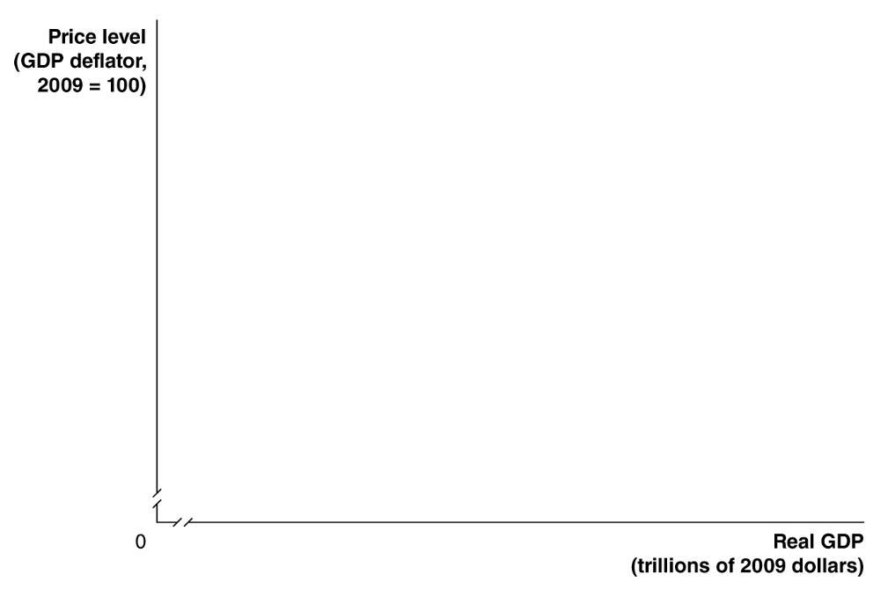
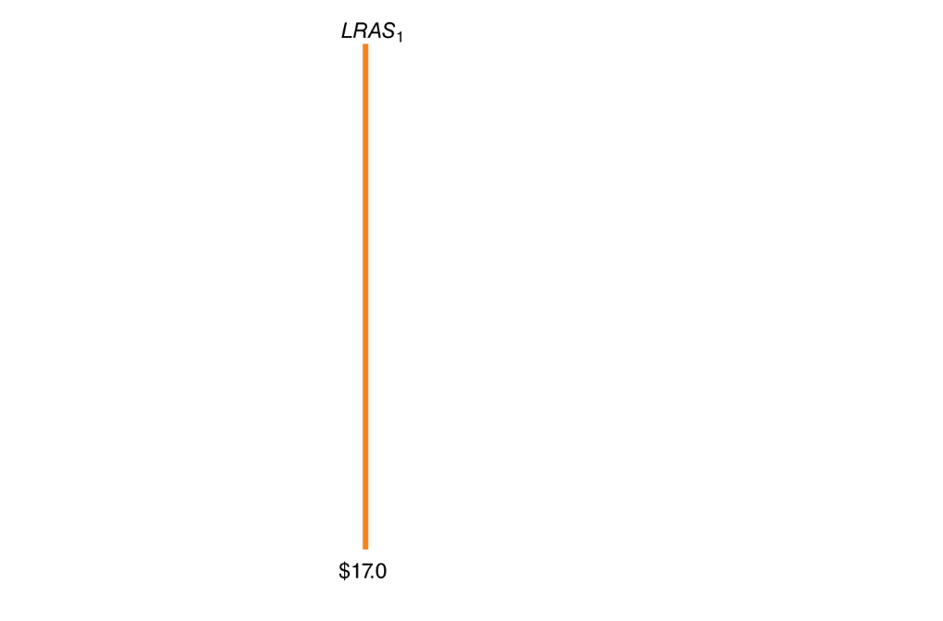
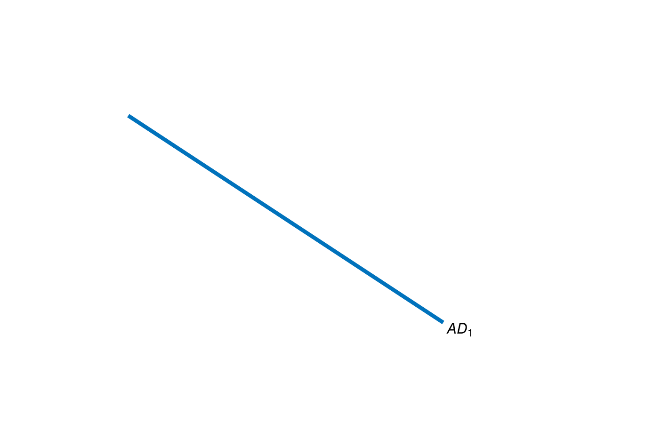
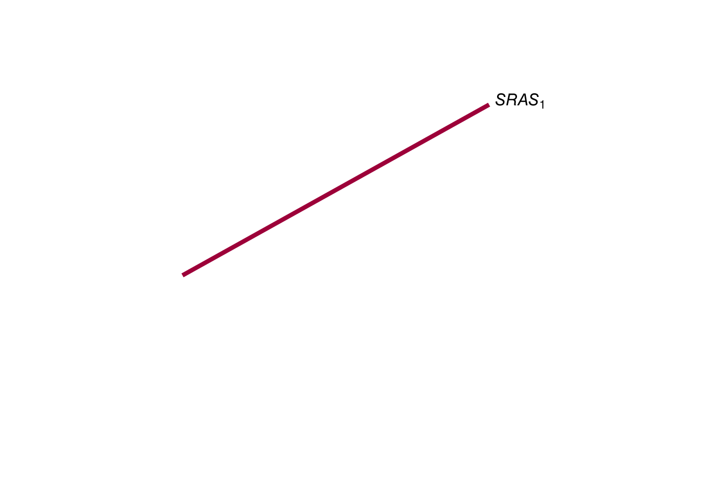
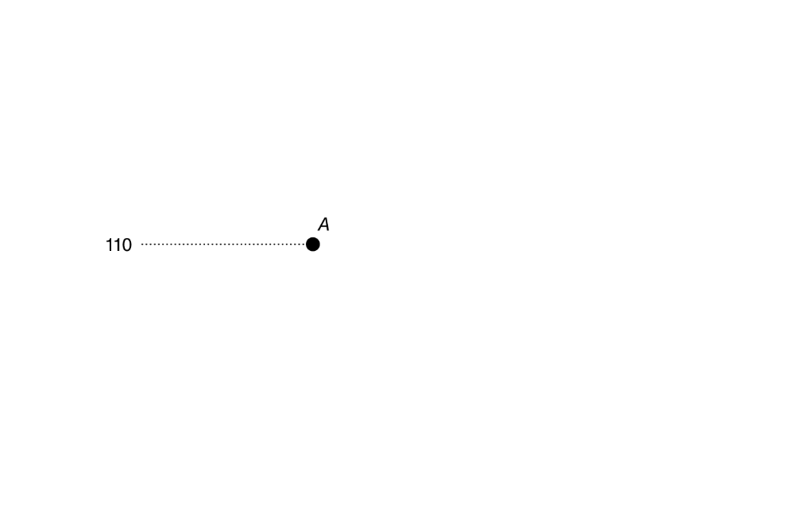
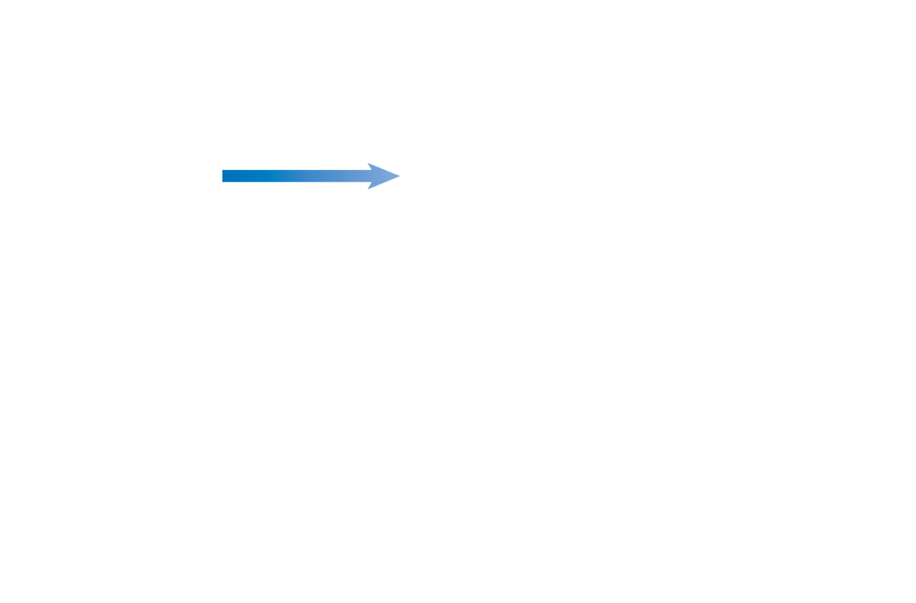
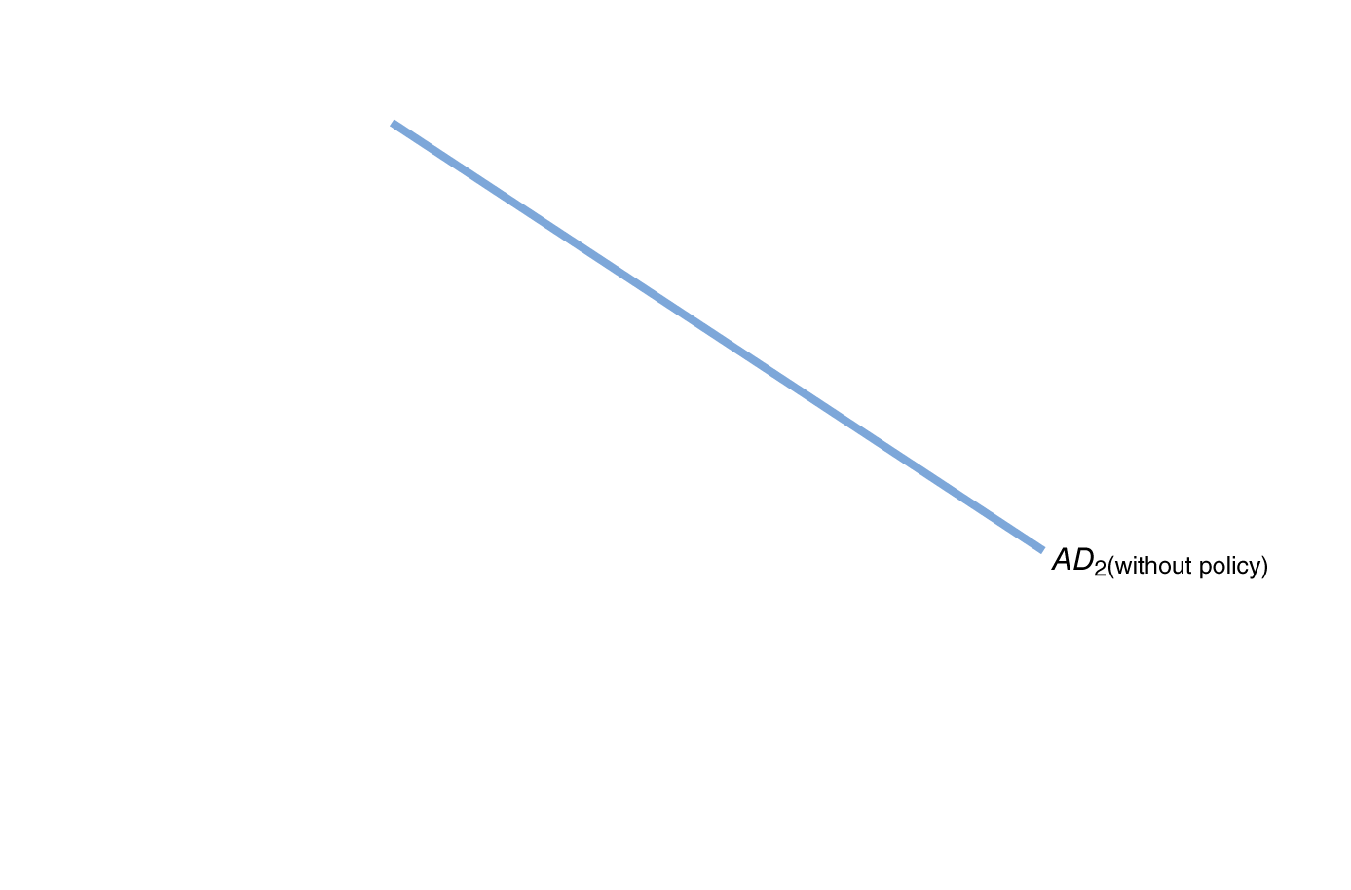

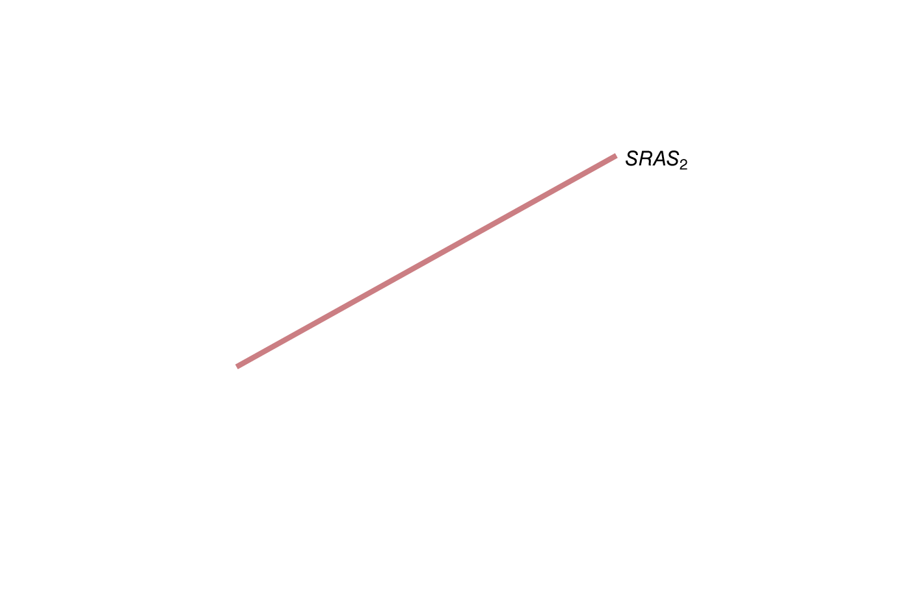
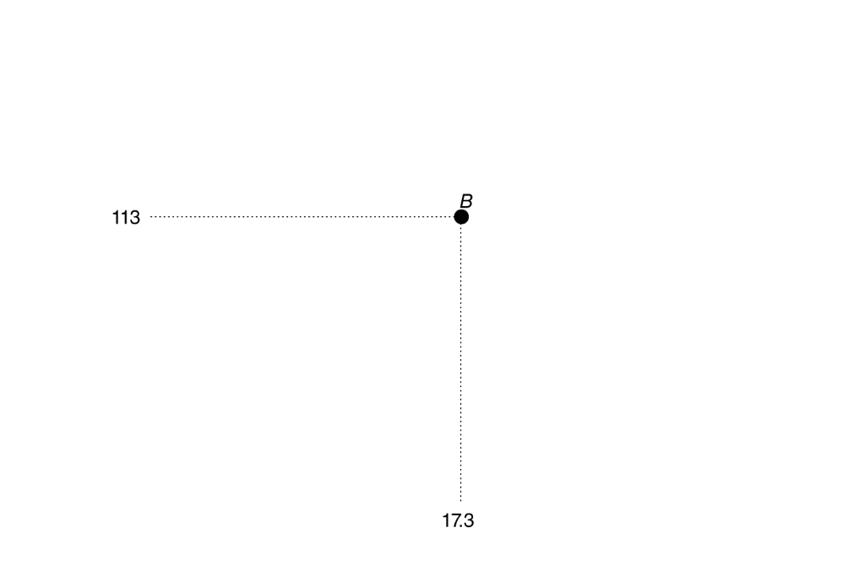
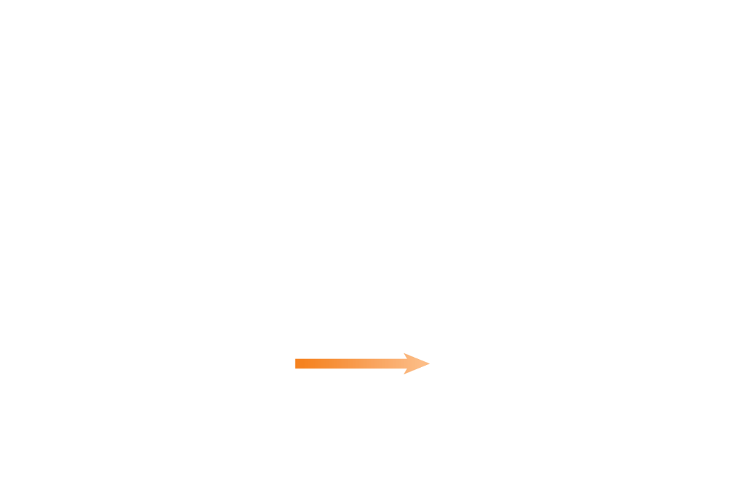
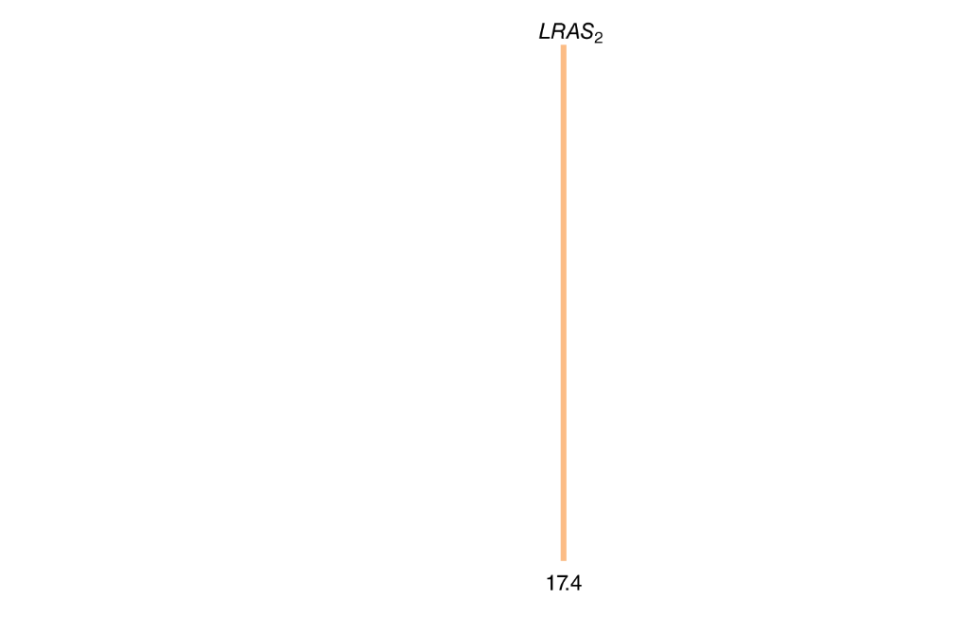
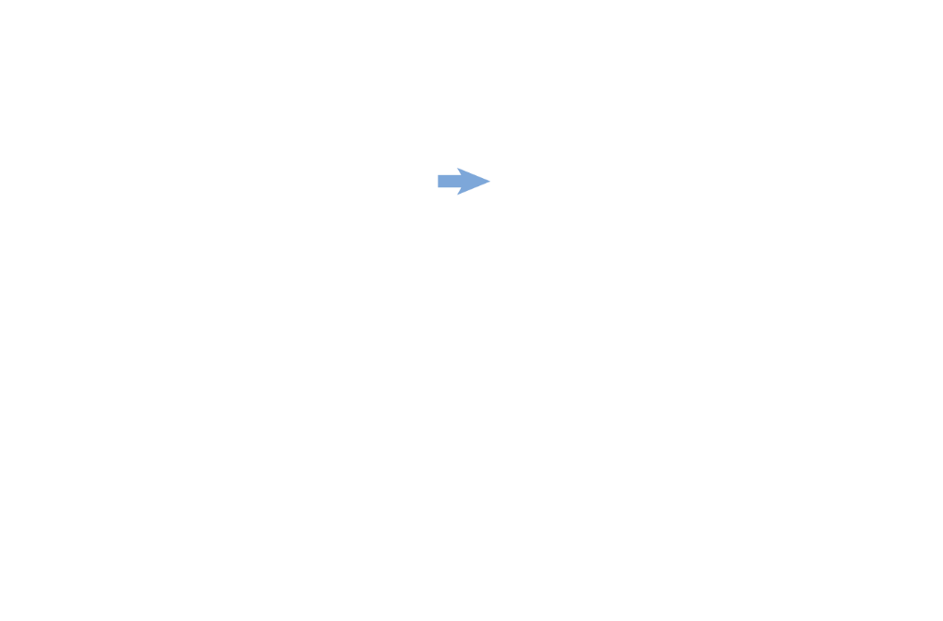



Expansionary fiscal policy in the dynamic AD-AS model
Initially, the economy is in long-run equilibrium.
The federal government projects that aggregate demand will not rise by enough to maintain full employment.
It enacts an expansionary fiscal policy to increase aggregate demand, hopefully to the full employment level.
The price level is higher than it would have been without the expansionary fiscal policy.
Figure 16.6
An expansionary fiscal policy in the dynamic model
Notes:
Equilibrium is initially at point A, with real
GDP equal to potential GDP of $17.0 trillion
and the price level equal to 110. Without an
expansionary policy, aggregate demand will
shift from AD1 to AD2(without policy), which is
not enough to keep real GDP equal to potential
GDP because long-run aggregate supply
has shifted from LRAS1 to LRAS2. The new
short-run equilibrium is at point B, with
real GDP of $17.3 trillion and a price level
of 113. Increasing government purchases or
cutting taxes will shift aggregate demand to
AD2(with policy). Equilibrium will be at point C,
with real GDP of $17.4 trillion, which is its
potential level, and a price level of 115. The
price level is higher than it would have been
without an expansionary fiscal policy.

Slide 19
















Contractionary fiscal policy in the dynamic AD-AS model
The economy starts once more in long-run equilibrium.
The federal government projects that aggregate demand will rise so
much that employment
is beyond the full-employment level, causing high inflation.
It enacts a contractionary fiscal policy to decrease aggregate demand, again ideally to the full employment level.
Figure 16.7
A contractionary fiscal policy in the dynamic model
Notes:
Equilibrium is initially at point A, with real
GDP equal to potential GDP of $17.0 trillion
and the price level equal to 110. Without a
contractionary policy, aggregate demand
will shift from AD1 to AD2(without policy),
which results in a short-run equilibrium
at point B, with real GDP of $17.5 trillion,
which is greater than potential GDP, and a
price level of 115. Decreasing government
purchases or increasing taxes can shift aggregate
demand to AD2(with policy). Equilibrium
will be at point C, with real GDP of
$17.4 trillion, which is its potential level,
and a price level of 113. The inflation rate
will be 2.7 percent, as opposed to the 4.5
percent it would have been without the contractionary
fiscal policy.

Slide 20
The Government Purchases and Tax Multipliers
16.4
Explain how the government purchases and tax multipliers work.

Slide 21







Aggregate demand and the multiplier effect
If the government increases its spending on goods and services, then aggregate demand increases immediately. This is the autonomous increase in aggregate demand.
Figure 16.8
The multiplier effect and aggregate demand
But then people receive this increased spending as increased income, and increase their consumption spending accordingly.
This is the induced increase in aggregate demand.
The series of induced increases in consumption spending that results from the initial increase in autonomous expenditures is known as the multiplier effect.
Notes:
An initial increase in government purchases
of $100 billion causes the aggregate demand
curve to shift to the right, from AD1 to the
dashed AD curve, and represents the effect
of the initial increase of $100 billion in
government purchases. Because this initial
increase raises incomes and leads to further
increases in consumption spending, the aggregate
demand curve will ultimately shift
further to the right, to AD2.

Slide 22










Multiplier effect of an increase in government purchases
Suppose each increase in spending induces half again as much consumption spending.
Over time, a $100 billion increase in government purchases will result in an additional $100 billion in induced consumption spending.
Figure 16.9
The multiplier effect of an increase in government purchases
Notes:
Following an initial increase in government purchases, spending and real GDP
increase over a number of periods due to the multiplier effect. The new spending
and increased real GDP in each period is shown in orange, and the level of spending
from the previous period is shown in blue. The sum of the blue and orange
areas represents the cumulative increase in spending and real GDP. In total, equilibrium
real GDP will increase by $200 billion as a result of an initial increase of
$100 billion in government purchases.

Slide 23
Multipliers for government purchases and taxes
We can describe the total effect of a change (increase or decrease) in government purchases or taxes by measuring the change in equilibrium real GDP.
The tax multiplier will be a negative number: an increase in taxes will decrease equilibrium real GDP, and vice versa.
We expect the tax multiplier to be smaller (in absolute value) than the government purchases multiplier.
Why? A $100 billion increase in purchases initially increases spending by $100 billion; but a $100 billion tax cut is partially spent and partially saved.

Slide 24
The effect of changes in tax rates
The tax multiplier applies to changes in the amount of taxes, without changes in tax rates.
Example: In 2009 and 2010, the federal government enacted the Making Work Pay Tax Credit: a $400 reduction in taxes for working individuals ($800 for households).
Decreases in tax rates have a slightly different effect:
Increasing the disposable income of households, leading them to increase their consumption spending
Increasing the size of the multiplier effect, since more of any increase in income becomes disposable income.

Slide 25












Taking into account the effect of aggregate supply
An increase in aggregate demand will not only result in real GDP rising; it will also result in a price level increase, because the short-run aggregate supply curve is upward-sloping.
Suppose that between the autonomous and induced effects, fiscal policy causes aggregate demand to increase by $1.2 trillion.
The resulting real GDP increase is smaller—only $1.0 trillion. The price level also rises.
Figure 16.10
The multiplier effect and aggregate supply
Notes:
Short-run equilibrium is initially at point A.
An increase in government purchases causes
the aggregate demand curve to shift to the
right, from AD1 to the dashed AD curve.
The multiplier effect results in the aggregate
demand curve shifting further to the right,
to AD2 (point B). Because of the upwardsloping
supply curve, the shift in aggregate
demand results in a higher price level. In the
new equilibrium at point C, both real GDP
and the price level have increased. The increase
in real GDP is less than that indicated
by the multiplier effect with a constant price
level.

Slide 26
The multipliers work in both directions
An increase in government purchases and a cut in taxes have a positive multiplier effect.
A decrease in government purchases and an increase in taxes have a negative multiplier effect.
Example: a reduction in government spending on defense initially affects defense contractors; but then it would spread to suppliers to and employees of those contractors, and then to other firms and workers.

Slide 27
The Limits of Using Fiscal Policy to Stabilize the Economy
16.5
Discuss the difficulties that can arise in implementing fiscal policy.

Slide 28
Can we use fiscal policy to stabilize the economy?
For several reasons, fiscal policy may be even less effective than monetary policy at countercyclical stabilization:
Timing fiscal policy is harder, due to:
  Legislative delay: Congress needs to agree on the actions
  Implementation delay: Large spending projects may take months or even years to begin, even once approved.
Government spending might crowd out private spending
Crowding out: A decline in private expenditures as a result of an increase in government purchases

Slide 29





Crowding out in the short run—money market
A temporary increase in government purchases will cause the demand for money, and hence the interest rate, to rise.
But with the higher interest rate, consumption, investment, and net exports all fall.
Figure 16.11
An expansionary fiscal policy increases interest rates
Notes:
An increase in government purchases
will increase the demand for money from
Money demand1 to Money demand2 as
real GDP and income rise. With the supply
of money constant, at $950 billion, the result
is an increase in the equilibrium interest
rate from 3 percent to 5 percent, which
crowds out some consumption, investment,
and net exports.

Slide 30













Crowding out in the short run—AD-AS model
A temporary increase in government purchases will cause the demand for money, and hence the interest rate, to rise.
With the higher interest rate, consumption, investment, and net exports all fall.
So the initial increase in spending…
… is partially offset by the crowding out.
Figure 16.12
The effect of crowding out in the short run
Notes:
Equilibrium is initially at point A, with
real GDP of $17.2 trillion below potential
GDP, so the economy is in a recession. In
the absence of crowding out, an increase in
government purchases will shift aggregate
demand to AD2(no crowding out) and equilibrium
is at potential GDP of $17.4 trillion
(point B). But the higher interest rate
resulting from the increased government
purchases will reduce consumption, investment,
and net exports, causing aggregate
demand to shift to AD2(crowding out). The result
is a new short-run equilibrium at point
C, with real GDP of $17.3 trillion, which is $100 billion short of potential GDP.

Slide 31
Crowding out in the long run
In the long run, the increase in government purchases will have no effect on real GDP: the reduction in consumption, investment, and net exports will exactly offset the increase in government purchases.
Why? Because in the long run, the economy returns to potential GDP, even without the government’s intervention.
The long run effect is simply to increase the size of the government sector within the economy.
Bear in mind that the long run may be many years away, however; so the intermediate increase in real GDP may be worth the cost.

Slide 32
Fiscal policy in action: the 2007-2009 recession
In early 2008, believing a recession was imminent, Congress authorized a tax cut: a one-time rebate of taxes already paid, totaling $95 billion.
This resulted in a boost to consumers’ current incomes. Changes to current incomes result in smaller increases in spending than changes to permanent incomes, because people seek to “smooth” their consumption over time.
Economists estimate that consumers spent about 33-40% of the rebates they received; so the tax cut resulted in about $35 billion in increased spending.

Slide 33














American Recovery and Reinvestment Act of 2009
Figure 16.13
The 2009 stimulus package
In 2009, Congress passed the “stimulus package”, a combination of increased government spending (about two-thirds)…
… and decreased taxes (about one-third).
At $840 billion, the stimulus package was by far the largest fiscal policy action in U.S. history.
Notes:
Congress and President Obama intended the spending increases and tax
cuts in the stimulus package to increase aggregate demand and help pull the
economy out of the 2007–2009 recession. Panel (a) shows how the increases
in spending were distributed, and panel (b) shows how the tax cuts were
distributed.
Source: Congressional Budget Office.

Slide 34










The effect of the stimulus on the federal budget
The effect of the stimulus package on federal expenditures and revenue was not immediate; but it mostly occurred over the following two years.
(a) The effect on expenditures
(b) The effect on revenues
Figure 16.14
The effect of the stimulus package on federal expenditures and revenue
Notes:
Congress and President Obama intended the spending increases and tax cuts in
the stimulus package to be temporary. Panel (a) shows the effect of the stimulus
package on federal expenditures was greatest during 2010 and declined in the
following
years. Panel (b) shows that the effect on federal government revenue was
greatest during 2010 and had declined to almost zero by early 2011.
Source: Federal Reserve Bank of St. Louis.

Slide 35
How effective was the stimulus package?
When the stimulus was passed, Obama administration economists believed that by the end of 2010, it would:
Increase real GDP by 3.5%
Increase employment by 3.5 million
By the end of 2010, real GDP actually rose by 4.4% but employment fell by 3.3 million.
Did the stimulus fail?
To judge the effect of the stimulus package, we have to measure its effects holding constant all other factors affecting real GDP and employment.
Isolating the effects of the stimulus package is very difficult; economists still differ in their views about how effective the stimulus package was.

Slide 36
CBO estimates of the effects of the stimulus
Year | Change in Real GDP | Change in the Unemployment Rate | Change in Employment (millions of people)
2009 | 0.4% to 1.8% | −0.1% to −0.5% | 0.3 to 1.3
2010 | 0.7% to 4.1% | −0.4% to −1.8% | 0.9 to 4.7
2011 | 0.4% to 2.3% | −0.2% to −1.4% | 0.6 to 3.6
2012 | 0.1% to 0.8% | −0.1% to −0.6% | 0.2 to 1.3
2013 | 0.1% to 0.4% | 0% to −0.3% | 0.1 to 0.5
Table 16.2
CBO estimates of the effects of the stimulus package
The Congressional Budget Office (CBO) is a non-partisan organization that estimates the effects of government policies.
The table shows CBO estimates of the effect of the stimulus package on economic variables, relative to what would have happened without the stimulus package:
The CBO’s conclusion: the stimulus package reduced the severity of the recession, but did not come close to bringing the economy back to full employment.

Slide 37
Why was the recession of 2007-2009 so severe?
The recession of 2007-2009 was the worst recession to hit the United States since the Great Depression of the 1930s.
 | Duration | Decline in Real GDP | Peak Unemployment Rate
Average for postwar recessions | 10.4 months | −1.7% | 7.6%
Recession of 2007–2009 | 18 months | −4.1% | 10.0%
The Great Depression of the 1930s was accompanied by a financial crisis—just like the recession of 2007-2009.
Are recessions generally worse when they are accompanied by a financial crisis?

Slide 38
The recession of 2007-2009—continued
After studying recessions accompanied by financial crises worldwide, economists Carmen Reinhart and Ken Rogoff say that such recessions are much more severe than average:
Economic Variable | Average Change | Average Duration of Change | Number of Countries
Unemployment rate | +7 percentage points | 4.8 years | 14
Real GDP per capita | −9.3% | 1.9 years | 14
Real stock prices | −55.9% | 3.4 years | 22
Real house prices | −35.5% | 6 years | 21
Real government debt | +86% | 3 years | 13
Note: Data above do not include the U.S. recession of 2007-2009.
Most people did not see the financial crisis coming, so they also underestimated how severe the 2007-2009 recession would be.

Slide 39
Estimates of the size of multipliers
How large are the multipliers for government purchases and for taxes? This question is very difficult to answer, and different economists produce different estimates:
Economist | Type of Multiplier | Size of Multiplier
Congressional Budget Office | Government purchases | 0.5–2.5
Lawrence Christiano, Martin Eichenbaum, and Sergio Rebelo | Government purchases | 1.05 (when short-term interest rates are not zero); 3.7 (when short-term interest rates are expected to be zero for at least five quarters)
Tommaso Monacelli, Roberto Perotti, and Antonella Trigari, Universita Bocconi | Government purchases | 1.2 (after one year) and 1.5 (after two years)
Ethan Ilzetzki, London School of Economics, Enrique G. Mendoza, and Carlos A. Vegh, University of Maryland | Government purchases | 0.8
Valerie Ramey, University of California, San Diego | Military expenditure | 0.6–1.1
Robert J. Barro, Harvard University, and Charles J. Redlick, Bain Capital, LLC | Military expenditure | 0.4–0.5 (after one year) and 0.6–0.7 (after two years)
Table 16.3
Estimates of the size of the multiplier

Slide 40
Estimates of the size of multipliers—continued
Economist | Type of Multiplier | Size of Multiplier
John Cogan and John Taylor, Stanford University, and Tobias Cwik and Volker Wieland, Gothe University | A permanent increase in government expenditures | 0.4
Christina Romer, University of California, Berkeley, and Jared Bernstein, chief economist and economic policy adviser to Vice President Joseph Biden | A permanent increase in government expenditures | 1.6
Christina Romer (prior to serving as chair of the Council of Economic Advisers) and David Romer, University of California, Berkeley | Tax | 2–3
Congressional Budget Office | Tax | 0.6–1.5 (two-year tax cut for lower- and middle-income people) and 0.1–0.6 (one-year tax cut for higher-income people)
Robert J. Barro, Harvard University, and Charles J. Redlick, Bain Capital, LLC | Tax | 1.1
Table 16.3 continued
Estimates of the size of the multiplier

Slide 41
Deficits, Surpluses, and Federal Government Debt
16.6
Define federal budget deficit and federal government debt and explain how the federal budget can serve as an automatic stabilizer.

Slide 42










The federal budget deficit, 1901-2013
The U.S. federal government does not generally balance its budget. Sometimes its revenues are higher than its expenditure, but usually the reverse is true—especially so during wartime.
Figure 16.15
The federal budget deficit, 1901-2013
Notes:
During wars, government spending increases
far more than tax revenues, increasing
the budget deficit. The budget deficit
also increases during recessions, as government
spending increases and tax revenues
fall.
Note: The value for 2013 is an estimate
prepared by the Congressional Budget Office
in May 2013.
Sources: Budget of the United States
Government, Fiscal Year 2003, Historical
Tables, Washington, DC: U.S. Government
Printing Office, 2002; U.S. Bureau of Economic
Analysis; and Congressional Budget Office.

Slide 43
Budget deficits and surpluses
A budget deficit occurs when the government’s expenditures are greater than its tax revenue.
A budget surplus occurs when the government’s expenditures are less than its tax revenue.
As the graph on the previous slide indicates, budget deficits often occur during wartime.
But they also occur during recessions, as tax receipts fall, and automatic stabilizers like increases in transfer payments (unemployment insurance, food stamps, etc.) take effect.
These automatic stabilizers are important for limiting the severity of a recession; many economists believe that the Great Depression of the 1930s was more severe because most of these automatic stabilizers did not exist then.

Slide 44
How large is the deficit in the United States?
Currently, the federal government runs a budget deficit; the CBO estimated in 2013 that the deficit for 2014 would be about 3.5% of real GDP.
How much of this deficit is due to the recession, and how much is due to government spending and tax policies?
We can identify this by looking at the cyclically adjusted budget deficit or surplus: the deficit or surplus in the federal government’s budget if the economy were at potential GDP.
The CBO estimated that the budget deficit would be 1.0% of real GDP in 2014 if real GDP were at its potential.
So this is the amount that spending needs to be cut, or taxes raised, in order to bring the federal budget into balance in the long run. The rest is due to automatic stabilizers.

Slide 45

Did fiscal policy fail during the Great Depression?
Government expenditures increased after the Great Depression of the 1930s as part of the “New Deal”, enacted by Franklin D. Roosevelt.
Similarly, there was a budget deficit each year in the 1930s (except 1937).
However recovery from the Great Depression was painfully slow.
Does show that expansionary fiscal policy didn’t work during the 1930s?
In fact, when we cyclically-adjust the budget deficits of the 1930s, we find that the federal government was not using expansionary fiscal policy at all. It had a cyclically adjusted budget surplus instead.

Slide 46
Fiscal policy during the Great Depression
Year | Federal Government Expenditures (billions of dollars) | Actual Federal Budget Deficit or Surplus (billions of dollars) | Cyclically Adjusted Budget Deficit or Surplus (billions of dollars) | Cyclically Adjusted Budget Deficit or Surplus as a Percentage of GDP
1929 | $2.6 | $1.0 | $1.24 | 1.20%
1930 | 2.7 | 0.2 | 0.81 | 0.89
1931 | 4.0 | −2.1 | −0.41 | −0.54
1932 | 3.0 | −1.3 | 0.50 | 0.85
1933 | 3.4 | −0.9 | 1.06 | 1.88
1934 | 5.5 | −2.2 | 0.09 | 0.14
1935 | 5.6 | −1.9 | 0.54 | 0.74
1936 | 7.8 | −3.2 | 0.47 | 0.56
1937 | 6.4 | 0.2 | 2.55 | 2.77
1938 | 7.3 | −1.3 | 2.47 | 2.87
1939 | 8.4 | −2.1 | 2.00 | 2.17
E. Cary Brown: “Fiscal policy, then, seems to have been an unsuccessful recovery device in the ‘thirties—not because it did not work, but because it was not tried.”

Slide 47
Should the federal budget be balanced?
Although many economists believe the federal budget should be balanced when the economy is at potential GDP, few believe it should be balanced during a recession.
During a recession, tax revenues fall; to balance the budget, spending would have to fall also—making the recession worse.
In fact, some economists argue that the federal budget should normally be in deficit. Just as households and firms borrow money to implement long-term investments, they argue that the federal government should do the same.

Slide 48








Federal government debt
When the federal government runs a budget deficit, it finances its activities by selling
Treasury securities.
The total value of those securities outstanding is known as the federal government debt, or the national debt.
The national debt increased dramatically as a percentage of GDP during the two world wars, and the two worst recessions. It is now at its highest level since 1947.
Figure 16.16
The federal government debt, 1901-2013
Notes:
The federal government debt increases
whenever the federal government runs a
budget deficit. The large deficits incurred
during World Wars I and II, the Great Depression,
and the 1980s and early 1990s increased
the ratio of debt to GDP. The large
deficits after 2008 caused the ratio to spike
up to its highest level since 1947.
Note: The value for 2013 is an estimate
prepared by the Congressional Budget Office
in May 2013.
Sources: U.S. Bureau of the Census,
Historical Statistics of the United States,
Colonial Times to 1970, Washington, DC:
U.S. Government Printing Office, 1975; Budget
of the United States Government, Fiscal Year
2003, Historical Printing Office, 2002; Federal
Reserve Bank of St. Louis; and Congressional
Budget Office.

Slide 49
Is government debt a problem?
For now, the federal government is at no serious risk of defaulting on its obligations, because:
The interest rate it can borrow money at is very low
The size of the interest payments on the debt is low relative to the size of the federal budget—around 11%
In the long run, a debt that increases in size relative to GDP can pose a problem—potentially crowding out investment, which is a key component of long term growth.
This problem is reduced if the government uses debt was incurred to finance infrastructure, education, or research and development; these serve as a long term investment for the economy.

Slide 50
The Effects of Fiscal Policy in the Long Run
16.7
Discuss the effects of fiscal policy in the long run.

Slide 51
Long-run fiscal policy
The fiscal policy we have concentrated on so far was intended to address short-run goals of stabilizing the economy.
But other fiscal policy actions are intended to have long-run impacts on potential GDP—i.e. on aggregate supply, rather than aggregate demand.
Hence these actions are often referred to as supply-side economics.
Most such policies are based on changing taxes in order to increase incentives to work, save, invest, and start a business.

Slide 52
The long-run effects of tax policy
Most taxes are assessed as a percentage of some economic activity, like individual income, corporate income, or capital gains.
When an individual decides how much to work, he bases the decision on how much an hour of work will increase his ability to consume goods and services—the posttax wage.
When a firm decides how many people to employ, it considers how much it has to pay in total for each worker: the pretax wage.
The difference between these is an example of a tax wedge: the difference between the pretax and posttax return to an economic activity.
A large tax wedge distorts the incentives of individuals and firms to take part in economic activities, generally resulting in lower levels of economic activity—lower real GDP.

Slide 53
Tax rates matter
Tax rates matter because the larger they are, the larger will be the behavioral response to the tax:
Individual income tax
  Affects labor supply decisions, and the returns to entrepreneurship
Corporate income tax
  Affects the incentives of firms to engage in investment
Tax on dividends and capital gains
  Affects the supply of loanable funds from households to firms, and hence the real interest rate
  Also affects the way firms disburse profits—2003 reduction in dividend tax led some firms like Microsoft to pay dividends for the first time

Slide 54
Tax simplification
Simpler taxes would also lead to economic gains for society.
The current tax code is extremely complicated—over 3,000 pages long.
The IRS estimates that taxpayers spend more than 6.4 billion hours each year filling out their tax returns—45 hours per tax return.
A simplified tax code would increase economic efficiency by reducing the number of decisions households and firms make solely to reduce their tax payments.

Slide 55









The economic impact of tax reform
Tax reform has
the potential to significantly increase real GDP in the long run beyond the increases that would otherwise occur.
The magnitude of the effect is uncertain, however.
For example, while people
might like to work more if tax
rates are lowered, they might be constrained by employers expecting a particular work week (like 40 hours). Economists believe that more study is needed on the impact of tax reforms.
Figure 16.17
The supply-side effects of a tax change
Notes:
The initial equilibrium is at point A. With
no tax change, the long-run aggregate supply
curve shifts to the right, from LRAS1 to
LRAS2. Equilibrium moves to point B, with
the price level falling from P1 to P2 and real
GDP increasing from Y1 to Y2. With tax reductions
and simplifications, the long-run
aggregate supply curve shifts further to the
right, to LRAS3, and equilibrium moves to
point C, with the price level falling to P3 and
real GDP increasing to Y2.

Slide 56
Common misconceptions to avoid
Fiscal policy and monetary policy have similar goals, but are different in their methods. Don’t confuse the two.
Deficit and debt are not the same. A deficit is the revenue shortfall in a given year, while the debt is the accumulation of prior deficits.
A balanced budget is not necessarily good; a budget deficit is not necessarily bad.
Government purchases and tax multipliers are for the short run; the long run multipliers are necessarily zero. But just because they are effective only in the short run, does not mean they are unimportant: the short run matters too!

Slide 57
Appendix: A Closer Look at the Multiplier
Apply the multiplier formula.

Slide 58
A closer look at the multiplier
Our objective in this appendix is to develop an econometric model for how real GDP is determined.
Then we will use that model to identify:
The government purchases and tax multipliers
How those multipliers are altered by tax rates
How those multipliers change in an open economy, i.e. when net exports change in response to income changes.
Throughout, we will assume that price levels do not change.

Slide 59
Finding equilibrium GDP (simple version)—setup
For simplicity, we will initially assume that taxes do not depend on income (i.e. they are a fixed amount), there are no government transfers to households, and there are no imports or exports.
(1) C = 1,000 + 0.75(Y − T) | Consumption function
(2) I = 1,500 | Planned investment function
(3) G = 1,500 | Government purchases function
(4) T = 1,000 | Tax function
(5) Y = C + I + G | Equilibrium condition
These numbers are in billions of dollars, except the marginal propensity to consume (MPC) of 0.75.
(Y-T) is disposable income.
Then we can write:
Y = 1,000 + 0.75(Y − 1,000) + 1,500 + 1,500

Slide 60
Finding equilibrium GDP (simple version)—cont.
Y = 1,000 + 0.75(Y − 1,000) + 1,500 + 1,500
= 1,000 + 0.75Y − 750 + 1,500 + 1,500
Subtracting 0.75Y from both sides, we obtain:
Y − 0.75Y = 1,000 − 750 + 1,500 + 1,500
0.25Y = 3,250
Thus we conclude that according to our model, real GDP will be $13 trillion.

Slide 61
An algebraic expression for equilibrium real GDP
Instead of inserting numbers, we could find an expression for real GDP algebraically. Let:
(1) C = C + MPC(Y − T) | Consumption function
(2) I = I | Planned investment function
(3) G = G | Government purchases function
(4) T = T | Tax function
(5) Y = C + I + G | Equilibrium condition
(The letters with bars represent fixed or autonomous variables.)
Then:

Slide 62
A formula for the government purchases multiplier
Any change in an autonomous variable will change the value of real GDP (Y). We can make that explicit by writing the variables in change form:
This uses the standard notation of ∆ for “change”.
Keeping autonomous consumption (C), taxes (T), and investment (I) constant, we get:
Divide both sides by ∆G to obtain the government purchases multiplier:
For example, if MPC = 0.75, the government purchases multiplier will be:

Slide 63
A formula for the tax multiplier
Let’s start again with the algebraic expression for real GDP:
Now we will keep autonomous consumption (C), investment (I), and government purchases (G) constant:
Divide both sides by ∆T to obtain the tax multiplier:
For example, if MPC = 0.75, the tax multiplier will be:
A $10 billion increase in taxes decreases real GDP by $30 billion.

Slide 64
The “balanced budget” multiplier
Suppose we increase government spending and taxes both by $10 billion; what would happen to real GDP?
Increase in real GDP from the increase in government purchases
Decrease in real GDP from the increase in taxes
Adding these effects and factoring out the $10 billion gives:
We can simplify this to:
So the balanced budget multiplier is 1: equal dollar increases in government spending and taxes increase real GDP by that amount—at least, in the short run.

Slide 65
Incorporating tax rates
In our model, taxes were autonomous. Now, we will make them depend on income. Assuming a tax rate of t, consumers will now have disposable incomes of (1-t)Y.
So the consumption function changes to:
Going through the same steps as before, we can obtain:
If MPC = 0.75 and t = 0.2, then:
If the tax rate t falls to 0.1, the multiplier becomes:
So lower tax rates yield larger multipliers.

Slide 66
The multiplier in an open economy
Now suppose we have imports and exports. Assume exports are autonomous, but the level of imports depends on income:
Here MPI is the marginal propensity to import: the fraction of additional income spent on imported goods.
Now we can write net exports as
Inserting this into our equation for equilibrium real GDP we get:
Following the same process as before, we can obtain a new expression for the government purchases multiplier:

Slide 67
The multiplier in an open economy—continued
Let MPC = 0.75, t = 0.2, and MPC = 0.1. Then:
This is smaller than the multiplier from before; a portion of spending goes on imports, which do not feed back in to higher income in our country.
If MPI increases to 0.2, then we have:
This is smaller still. An increase in the amount of additional income leaving the country as payments for imports decreases the multiplier effect of additional government purchases.

